Slide 1
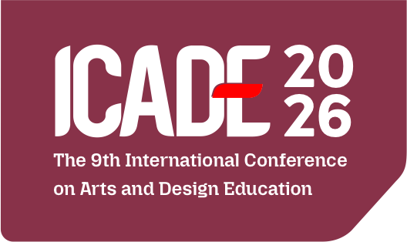

Transforming Cepot: Sundanese Cultural Identity in
Contemporary Visual Communication Design
Visual Communication Design and Digital Creativity in the Intelligent Era
Presented by:
Yayat Sudaryat
Asep Kadarisman
Affiliation:
Faculty of Creative Industries, Telkom University, Bandung, Indonesia

Slide 2
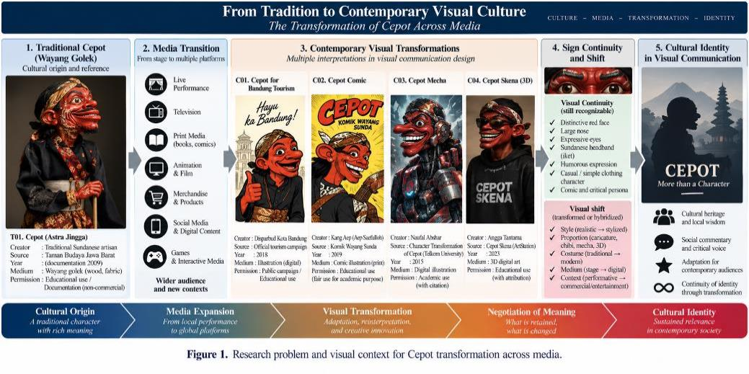
1. Background & Research Problem
Cepot (Astrajingga) is a prominent panakawan figure in Sundanese wayang golek, combining humour, social commentary, and cultural communication.
Across illustration, animation, merchandise, social media, branding, and digital formats, Cepot is increasingly simplified, exaggerated, hybridized, or recontextualized.
The central problem is not whether Cepot should change, but how transformation can retain cultural legibility while responding to contemporary media.
Recognizability must be examined as a configuration of visual signs—not through one feature alone.
ICADE 2026 | 2

Slide 3
2. Research Questions & Contribution
What visual characteristics constitute a recognizable traditional reference field for Cepot?
What recurrent patterns of visual transformation appear across selected contemporary representations?
How do transformations preserve, adapt, or reframe signs associated with Sundanese cultural identity and Cepot’s communicative function?
Contribution: a transferable framework for culturally grounded transformation of traditional characters.
ICADE 2026 | 3

Slide 4
3. From Tradition to Contemporary Visual Culture
ICADE 2026 | 4

Slide 5
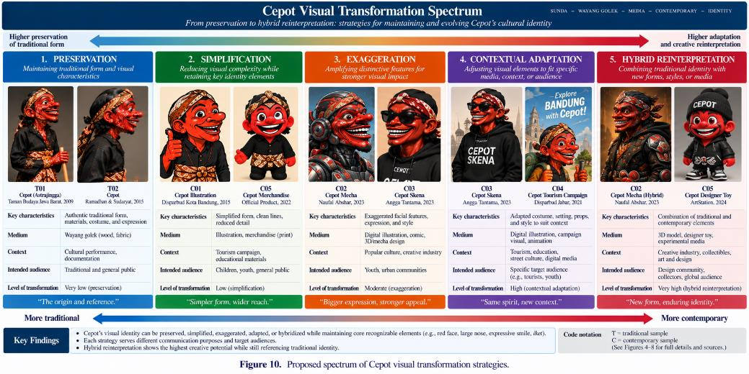
4. Traditional Cepot Reference Field
The study treats tradition as a reference field rather than a single canonical model.
Recurring cues include the red facial field, emphatic mouth/teeth, caricatural facial configuration, dark clothing, and performance-oriented puppet body.
Carving detail, costume pattern, surface finish, proportion, and pose can vary while Cepot remains culturally legible.
ICADE 2026 | 5

Slide 6
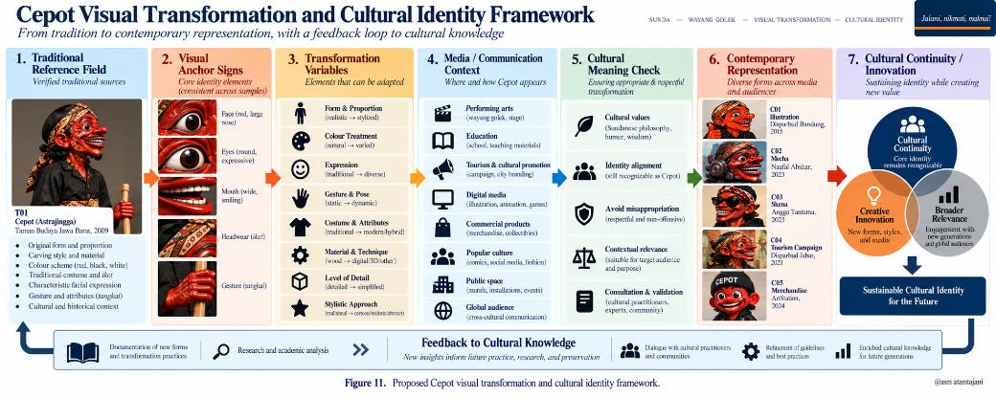
5. Analytical Framework
Traditional Reference Field → Visual Signifiers → Transformation Variables → Media & Communication Context → Cultural Meaning Check → Contemporary Representation.
Eight dimensions: form, proportion, colour, expression, gesture, costume/attributes, media context, and communication purpose.
Interpretation distinguishes visible continuity from culturally specific meaning.
ICADE 2026 | 6

Slide 7
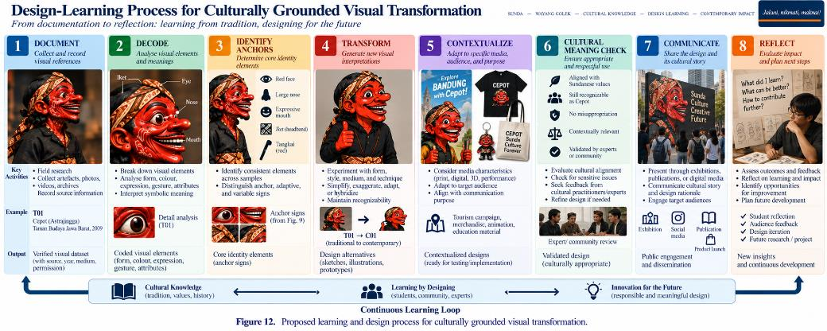
6. Methodology
Descriptive qualitative design combining comparative visual analysis, semiotic interpretation, and contextual analysis.
Two corpora: 3 verified traditional-reference samples (T01–T03) and 5 contemporary transformation samples (C01–C05).
Contemporary corpus spans character/mascot design, vector illustration, mecha hybridization, and 3D anamorphic animation.
Two analytical passes: descriptive coding of observable features and metadata, followed by comparative/semiotic coding.
ICADE 2026 | 7

Slide 8
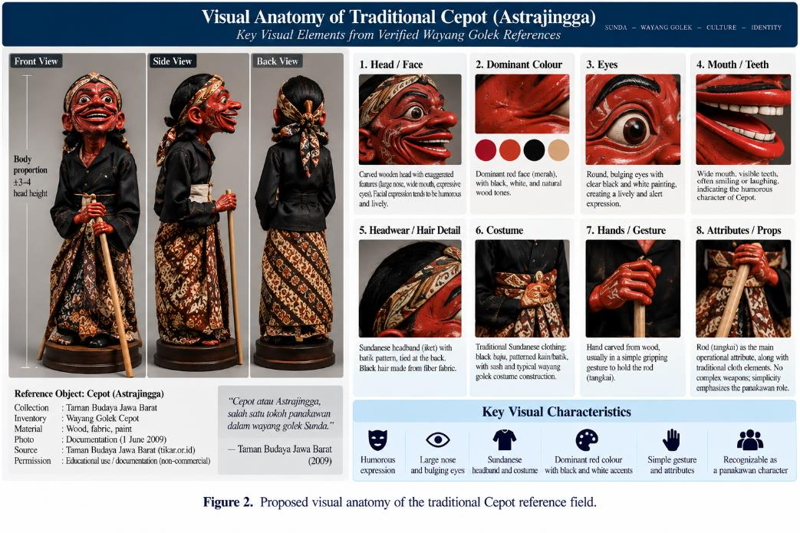
7. Standardized Comparative Visual Coding
Form: silhouette, head form, body geometry.
Proportion: head-to-body relation and exaggeration.
Colour: dominant hues and distribution.
Expression & gesture: eyes, mouth, brows, pose, bodily communication.
Costume/attributes, media context, and communication purpose are documented independently.
ICADE 2026 | 8

Slide 9
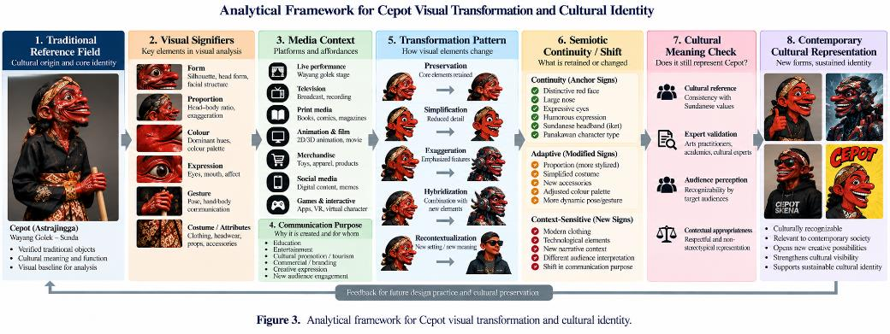
8. Results — Traditional Reference Field
Across T01–T03, Cepot remains recognizable through a recurrent configuration rather than exact replication.
Strongest recurring cues: red face, emphatic mouth/teeth, comic facial configuration, and dark clothing.
Variable elements include craft detail, costume pattern, surface finish, proportion, pose, and accessories.
ICADE 2026 | 9

Slide 10
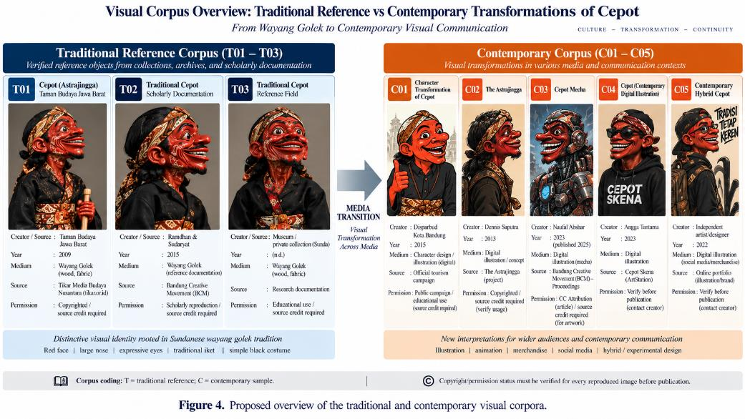
9. Form & Proportion Transformation
Five recurrent strategies: controlled simplification, expressive exaggeration, geometric/vector reduction, thematic hybridization, and medium-driven volumetric restyling.
C01–C02 reorganize puppet morphology for character/mascot functions; C03 intensifies graphic contour; C04 introduces a mechanical body; C05 translates Cepot into a volumetric urban figure.
Face, comic expressiveness, and broad Cepot silhouette are more stable than exact puppet proportions.
ICADE 2026 | 10

Slide 11
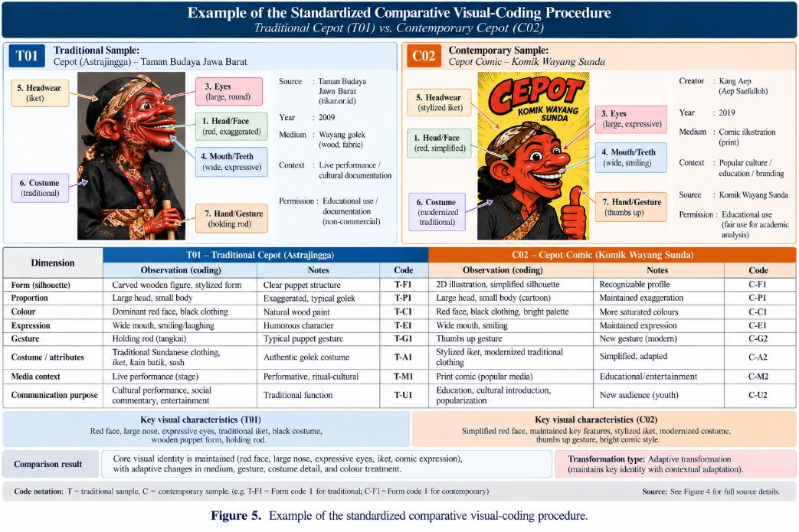
10. Colour, Expression, Gesture & Attributes
Colour continuity is strongest in the retained red facial field.
Contemporary representations expand secondary palettes into graphic, metallic, neon, or streetwear accents.
Facial expression remains comic/assertive but is often intensified; gesture shifts toward posed, animated, or action-oriented body language.
Costume and attributes are among the most flexible elements.
ICADE 2026 | 11

Slide 12
11. Media Context & Communication Purpose
Media affordance explains part of visual change: vector media favour contour clarity; mascots favour immediate recognition; 3D anamorphic display favours volume, motion, and spectacle.
Across formats, identity is maintained through a limited set of recurring cues—especially red face, comic facial structure, and recognizable attitude.
Transformation must be interpreted as a relationship among form, affordance, audience, and communication goal.
ICADE 2026 | 12

Slide 13
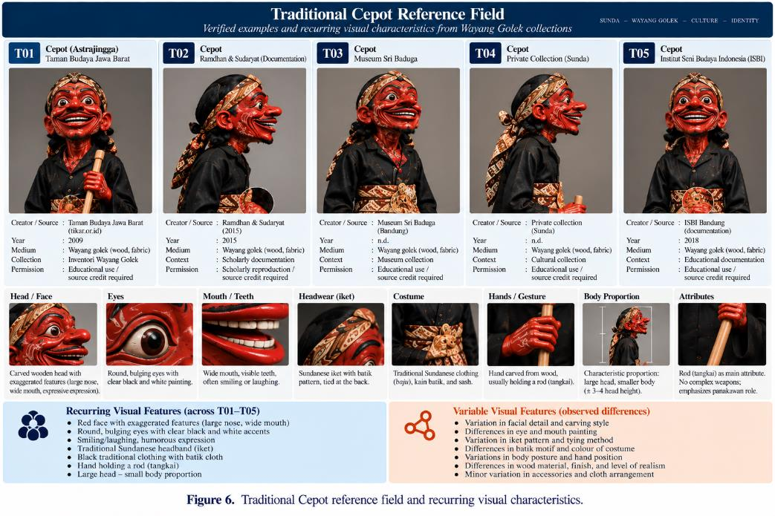
12. Semiotic Continuity & Shift
Anchor signs: red facial field, distinctive mouth/teeth, caricatural comic expression, overall facial configuration.
Adaptive signs: body proportion, costume detail, surface rendering, gesture, and geometric simplification.
Context-sensitive signs: culturally specific clothing, performance attributes, and substitutions that may alter the relation to Sundanese wayang golek.
Recognizability alone does not guarantee cultural integrity.
ICADE 2026 | 13

Slide 14
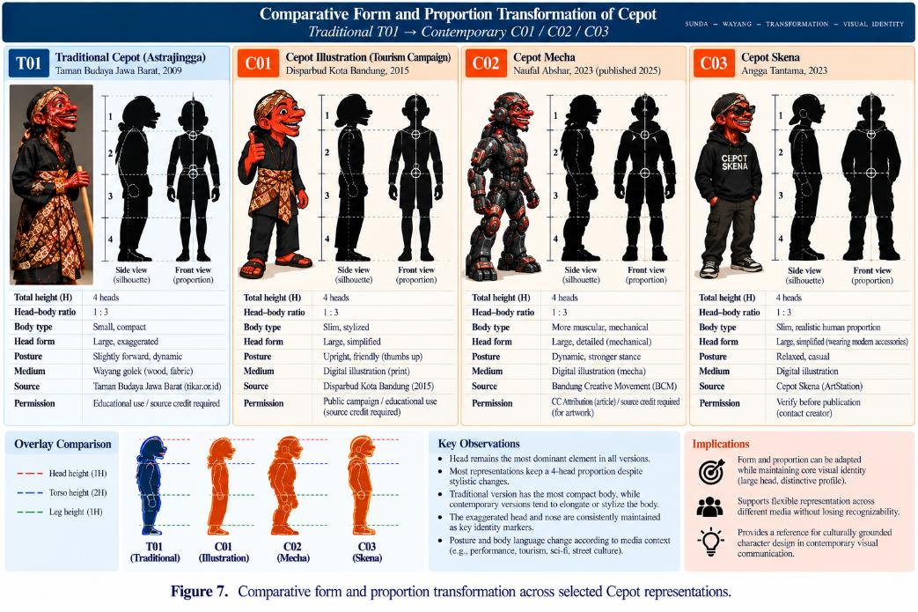
13. Cepot Visual Transformation Spectrum
Five clusters: preservation/reference documentation; controlled character adaptation; graphic stylization; hybrid reinterpretation; contextual/experiential re-staging.
This spectrum is not a good-to-bad hierarchy.
Even strong departures such as mecha and urban street-culture recontextualization can retain identity when anchor signs remain legible.
ICADE 2026 | 14

Slide 15
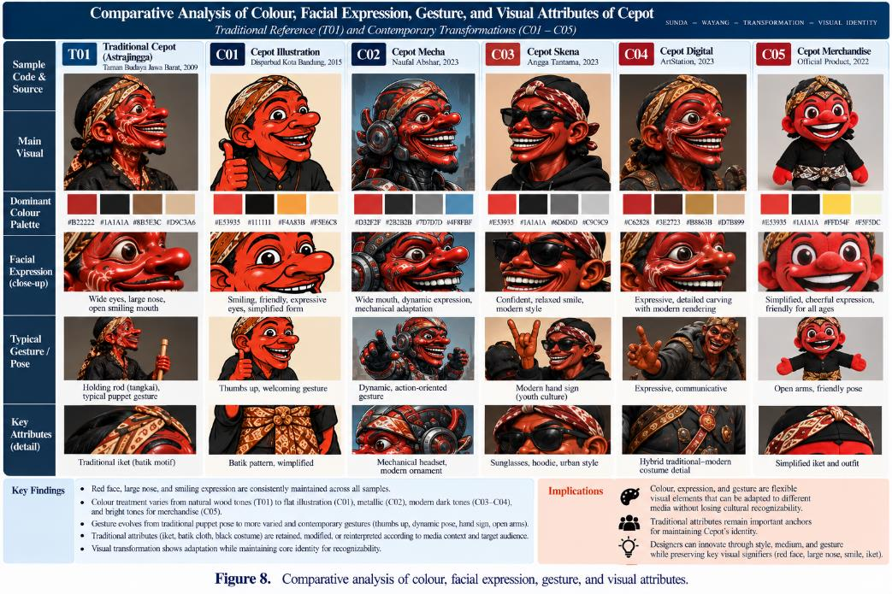
14. Proposed Cepot Visual Transformation & Cultural Identity Framework
The principal conceptual outcome links traditional reference, anchor signs, transformation variables, media context, cultural meaning checks, and contemporary representation.
The process begins with documentation—not stylization.
Design decisions should be evaluated for both visual recognizability and cultural legibility.
ICADE 2026 | 15

Slide 16
15. Discussion — Continuity-in-Transformation
Cultural continuity is not visual immobility; it is controlled negotiation between inherited signs and new representational conditions.
Anchor signs provide continuity, while adaptive signs enable media-responsive redesign.
Media affordance is a cultural design variable because platforms actively shape form, movement, scale, and communication.
Commercialization becomes risky when recognizable cues are detached from cultural context and reduced to generic mascot language.
ICADE 2026 | 16

Slide 17
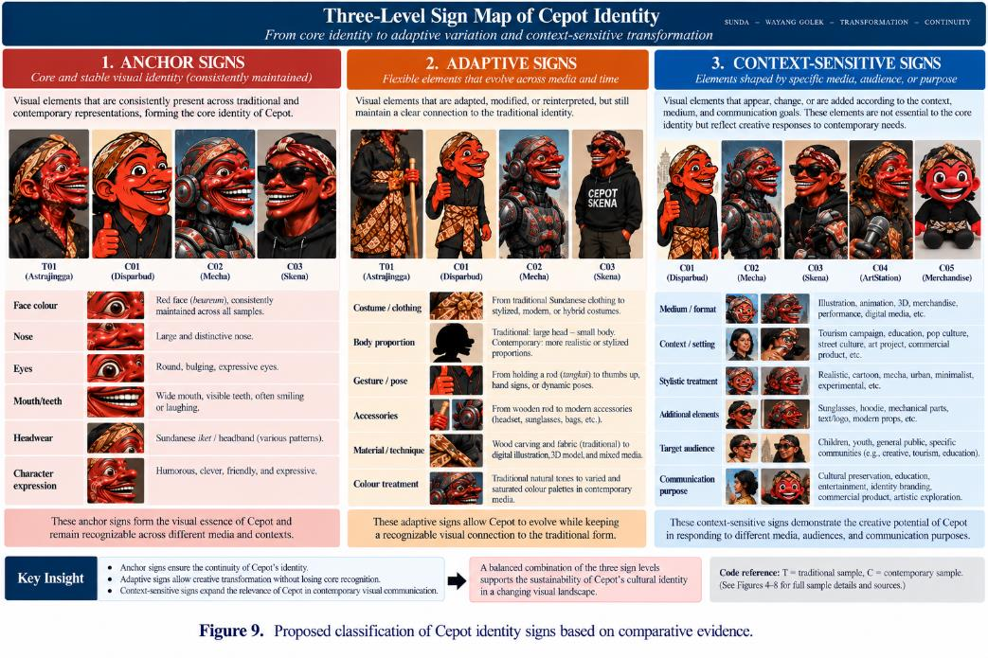
16. Implications for Visual Communication Design
Begin with cultural research and verified visual references.
Separate anchor, adaptive, and context-sensitive signs before redesign.
Match transformation decisions to medium, audience, and communication purpose.
Use cultural meaning checks before finalizing contemporary representations.
For design education, Cepot can become a case for teaching semiotics, visual transformation, provenance, and ethical cultural adaptation.
ICADE 2026 | 17

Slide 18
17. Limitations & Future Research
Small purposive corpus: 3 traditional and 5 contemporary samples; not exhaustive of all Cepot representations.
Author-led qualitative analysis; no statistical inter-coder reliability is claimed.
Cultural meaning is constrained by published scholarship and documented context; practitioner/community validation would strengthen future work.
Future studies can expand the corpus, compare audience interpretation, investigate creator intention, and test the framework in design practice.
ICADE 2026 | 18

Slide 19
18. Conclusion
Cepot’s contemporary transformation is best understood as continuity-in-transformation rather than preservation versus modernization.
Visual identity persists through configurations of anchor signs while adaptive elements respond to media and communication needs.
Cultural integrity requires more than resemblance: transformation should remain connected to cultural knowledge, provenance, context, and communicative function.
The proposed framework offers an evidence-based pathway for culturally grounded character design.
ICADE 2026 | 19

Slide 20
Thankyou
Presented by:
Yayat Sudaryat
Asep Kadarisman
Affiliation:
Faculty of Creative Industries, Telkom University, Bandung, Indonesia

