Slide 1


Representation of North Bali Tourism Identity in Discover the Uniqueness of North Bali: A Cinematographic Analysis
Film, Television, and Digital Storytelling in Transforming Global Culture
Presented by:
Putu Raka Setya Putra
Yayat Sudaryat
Affiliation:
Faculty of Creative Industries, Telkom University, Bandung, Indonesia

Slide 2
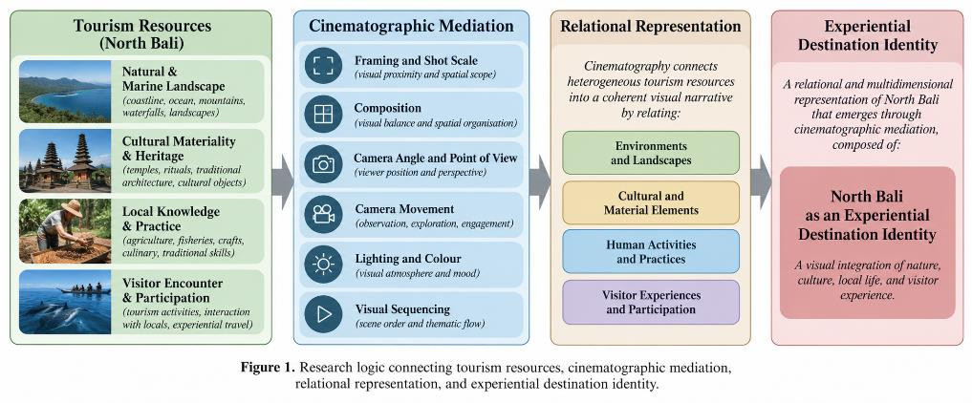
1. Background & Research Problem
How cinematography organises the representation of North Bali
• Tourism promotional videos do more than display attractions; they organise how destinations are visually encountered and interpreted.
• North Bali should not be treated as a complete or homogeneous cultural reality through a single promotional video.
• The analytical problem is not only what tourism resources appear, but how they are connected through framing, viewpoint, movement, colour, and sequence.
• The study focuses on the North Bali represented within the audiovisual text.
ICADE 2026 | 2

Slide 3
2. Research Questions & Contribution
• What cinematographic patterns are used in Discover the Uniqueness of North Bali?
• How do framing, composition, point of view, camera movement, lighting, colour, and visual sequencing organise environmental, cultural, material, and experiential content?
• What broader representation of North Bali emerges from relationships among these visual elements and scenes?
• Contribution: a Cinematographic Destination Identity Model linking tourism resources, cinematic mediation, and experiential destination identity.
ICADE 2026 | 3

Slide 4
3. Research Logic
Tourism resources → cinematographic mediation → relational representation → identity
ICADE 2026 | 4

Slide 5
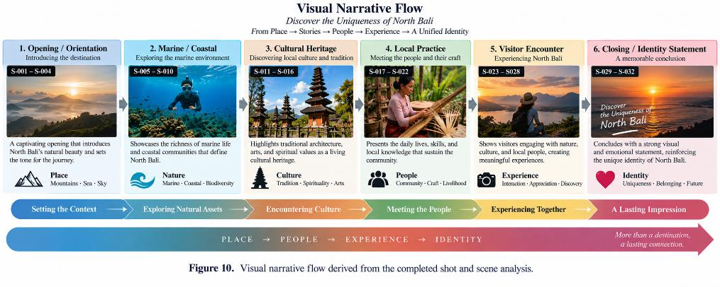
4. Analytical Framework
Formal choices are interpreted through scene relations, not isolated techniques
ICADE 2026 | 5

Slide 6
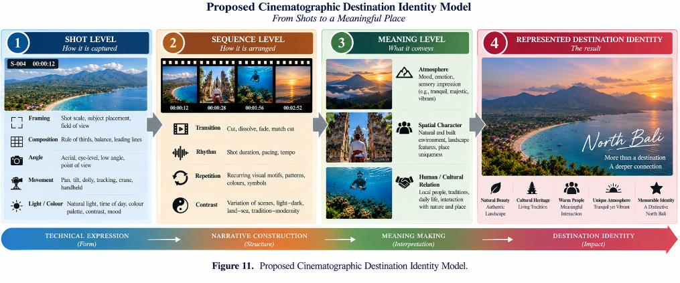
5. Methodology
Descriptive qualitative visual-text analysis
• Research object: YouTube video Discover the Uniqueness of North Bali, duration 5:32.
• Working copy: 16:9, 640 × 360 pixels, 24 fps; accessed 22 September 2026.
• Shot segmentation: visible edit points → shot IDs → scene clusters.
• Six coding dimensions: shot scale, composition, angle/POV, movement, lighting/colour, and visual flow.
• Single-researcher iterative viewing and recoding; interpretation separated from observable formal description.
ICADE 2026 | 6

Slide 7
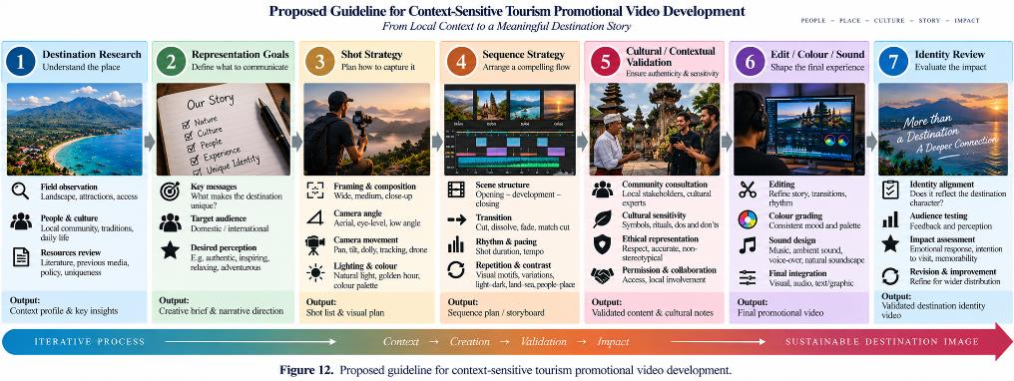
6. Shot-Level Cinematographic Coding
Evidence is recorded before interpretive claims are made
• Framing / shot scale: ELS, LS/WS, MS, CU, ECU.
• Composition: depth, salience, balance, lines, negative space.
• Angle / POV: aerial, high, eye-level, low.
• Movement: static, pan, tilt, tracking, push/pull, aerial.
• Lighting / colour: brightness, contrast, warmth, palette, continuity.
• Interpretive caution: no fixed symbolic meaning is assigned to a technique in isolation.
ICADE 2026 | 7

Slide 8
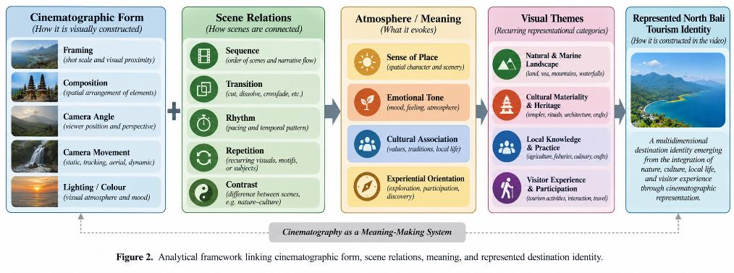
7. Overall Visual Structure
Six recurring content clusters across the 5:32 video
• Natural / landscape orientation
• Marine / coastal imagery
• Cultural heritage and materiality
• Craft / local production and practice
• Visitor encounter and participation
• Integrated destination image
• The sequence connects spatial overview with human activity, detail, local practice, and visitor experience.
ICADE 2026 | 8

Slide 9
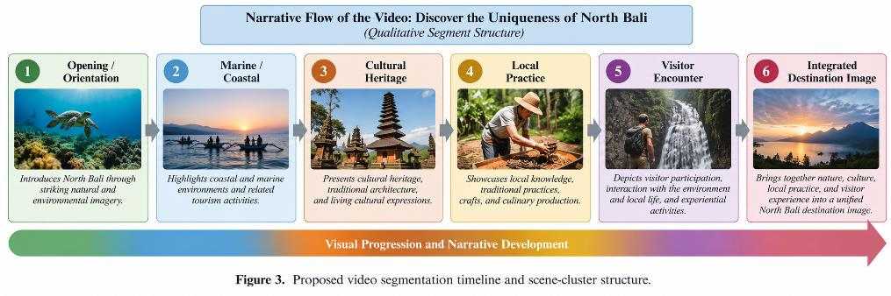
8. Framing & Composition
A recurrent shift from environmental scale to visual intimacy
• Wide / long shots establish geographical scale and spatial orientation.
• Medium framing connects people with activities and settings.
• Close/detail framing redirects attention toward material, craft, bodily action, and experiential detail.
• The key finding is the recurrent scale shift—not a numerical frequency claim.
ICADE 2026 | 9

Slide 10
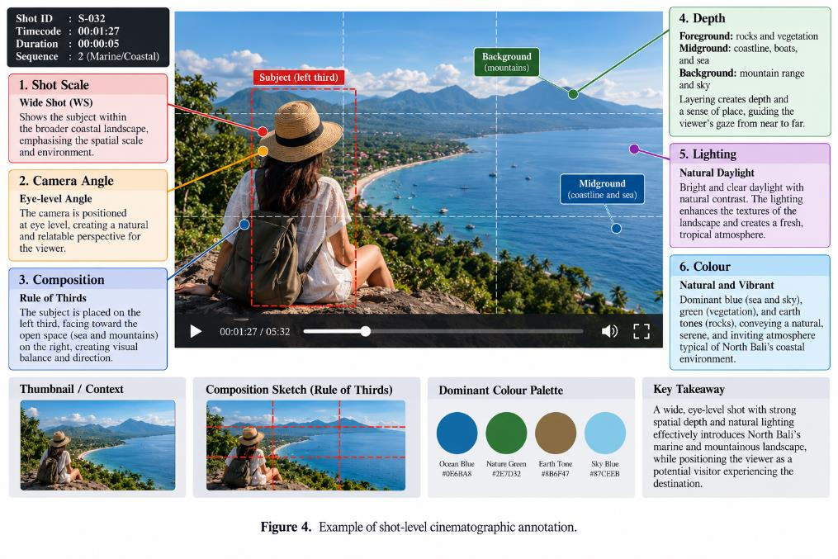
9. Camera Angle & Point of View
From overview toward encounter
• Elevated and aerial viewpoints primarily establish spatial overview.
• Eye-level viewpoints become more prominent around people, practices, and visitor participation.
• This shift reduces visual distance as the narrative moves from destination overview toward encounter.
• Low viewpoints were not recurrent enough to support a separate identity claim.
ICADE 2026 | 10

Slide 11
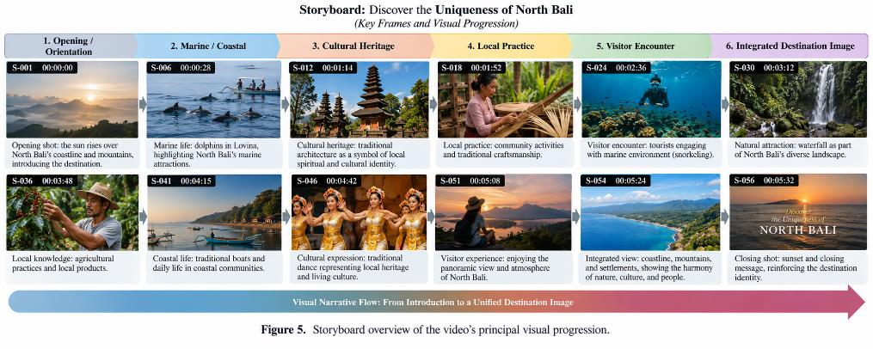
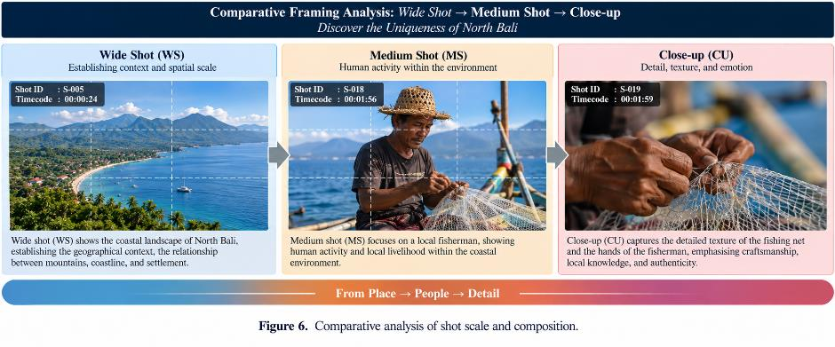
10. Movement, Lighting & Colour
Cinematography supports spatial discovery and visual continuity
Movement opens and connects space; blue–green natural palettes, earth tones, and warmer human/material accents help connect heterogeneous settings.
ICADE 2026 | 11

Slide 12
11. Four Recurring Destination-Identity Themes
• 1. Natural & Marine Landscape — environmental scale, coastal context, blue–green palette.
• 2. Cultural Materiality & Heritage — closer framing and attention to objects, textures, and visible heritage.
• 3. Local Knowledge & Practice — human-scale observation of making and embodied practice.
• 4. Visitor Encounter & Participation — dynamic movement and action continuity shift the visitor from observer toward participant.
• Synthesis: Landscape → Cultural Practice → Local Knowledge → Visitor Encounter → Experiential Destination Identity.
ICADE 2026 | 12

Slide 13
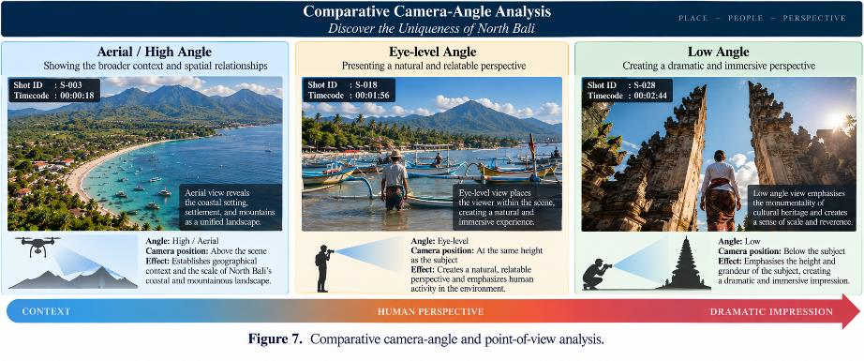
12. Visual Narrative Flow
Destination identity emerges cumulatively across sequences
ICADE 2026 | 13

Slide 14
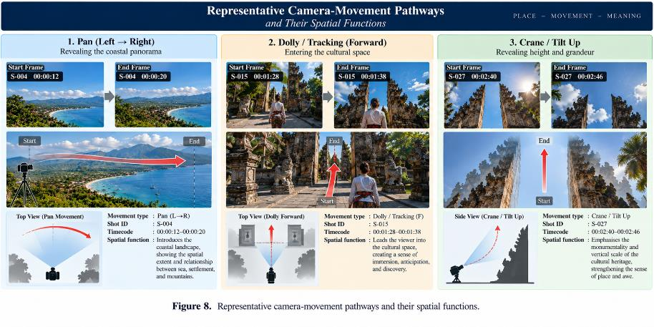
13. Main Contribution
Cinematographic Destination Identity Model
ICADE 2026 | 14

Slide 15
14. Discussion & Design Implications
• Cinematography functions as an identity-construction system, not merely as a set of production techniques.
• Destination identity is produced through interaction between represented content and cinematic form.
• Sequence prevents over-reading isolated screenshots: meaning develops through recurrence, transition, duration, and relation among scenes.
• For tourism promotion, destination research and representation goals should precede shot planning.
• Context-sensitive promotion should avoid decontextualising people, rituals, sacred spaces, or cultural practices.
ICADE 2026 | 15

Slide 16
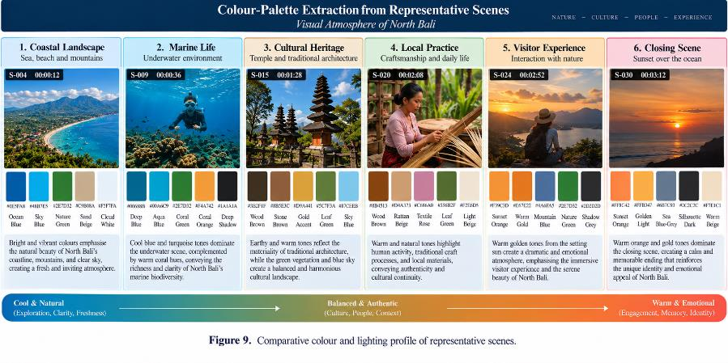
15. Context-Sensitive Tourism Video Development
Practical implication for visual communication design
ICADE 2026 | 16

Slide 17
16. Limitations & Future Research
• Single promotional video; findings cannot represent the full diversity of North Bali tourism communication.
• Visual-text analysis cannot establish audience interpretation, persuasion, emotional response, or visit intention.
• Production intention cannot be inferred without interviews, storyboards, briefs, or production documents.
• Cultural and locational claims require contextual verification beyond visual evidence.
• No comparative South Bali video corpus was analysed.
• Future research: exhaustive shot logging, multi-video corpus, North–South comparison, audience studies, and integrated sound/music/narration analysis.
ICADE 2026 | 17

Slide 18
17. Conclusion
North Bali is represented relationally rather than through a single dominant attraction
Shot-Level Form → Sequence-Level Relations → Meaning / Identity Patterns → Represented Destination Identity
• Wide environmental views establish spatial scale; closer views foreground cultural/material detail; movement and visitor-centred sequences add experiential dimensions.
• The study proposes that destination identity emerges not only from what is shown, but from how environmental, cultural, material, and experiential elements are cinematographically connected.
• The Cinematographic Destination Identity Model is the study’s principal conceptual contribution.
ICADE 2026 | 18

Slide 19
Thankyou
Presented by:
Putu Raka Setya Putra
Yayat Sudaryat
Affiliation:
Faculty of Creative Industries, Telkom University, Bandung, Indonesia

