Slide 1
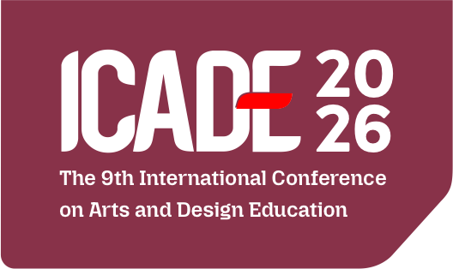

Gayo Alas Ethnic Jewelry in the Innovation and Collaboration Ecosystem of Smart Tourism
Sustainability, Cultural Heritage, and Creative Futures in Arts Education
Presented by:
Asep Sufyan Muhakik Aamtajani AtamtajaniPutu Raka Setya Putra
Affiliation:
Faculty of Creative Industries, Telkom University, Bandung, Indonesia

Slide 2
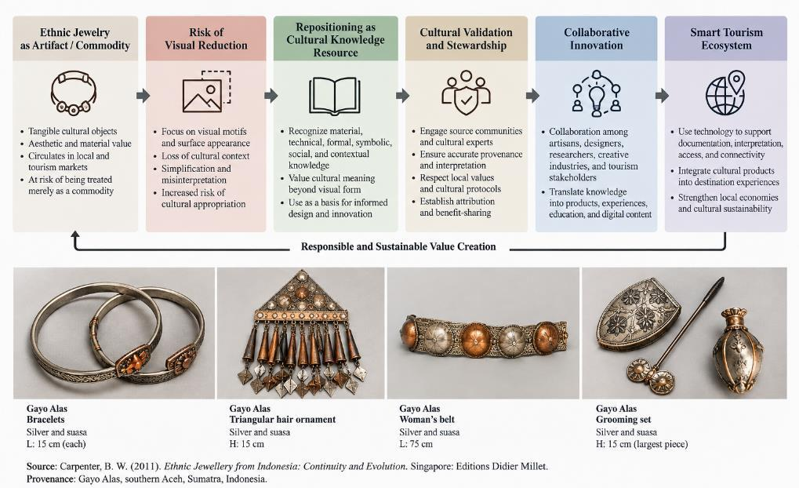
1. Background & Research Problem
From decorative object to a cultural knowledge resource
• Ethnic jewelry can carry material knowledge, technical skill, social practice, identity, and relationships to place.
• Risk: heritage innovation may begin with visual extraction—motifs are simplified before their context is understood.
• Gayo and Alas must not be treated as one homogeneous cultural category; provenance and validation are essential.
• Research gap: heritage, collaboration, creative tourism, and smart tourism are often discussed separately.
Presented by:
Author’s Full Name
Research problem and repositioning logic
ICADE 2026 | 2

Slide 3
2. Research Questions & Contribution
• What forms of cultural knowledge can be identified through contextual reading of Gayo and Alas jewelry-related artifacts?
• How can this knowledge circulate among cultural custodians, artisans, designers, researchers, tourism actors, and digital actors without reducing heritage to visual appropriation?
• How can smart tourism operate as an enabling ecosystem for interpretation, collaboration, innovation, and cultural continuity?
• Contribution: a Cultural Knowledge–Innovation–Smart Tourism Framework.
ICADE 2026 | 3

Slide 4
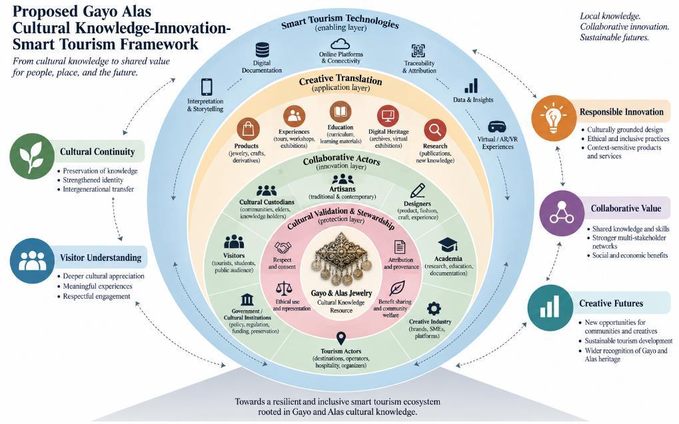
3. Cultural Knowledge Anatomy
Six analytical layers used to read ethnic jewelry
• Material — metals, alloys, surface, provenance
• Technical — forming, joining, filigree, finishing
• Formal / visual — form, motif, scale, body placement
• Symbolic — documented meanings and associations
• Social — maker, wearer, status, ceremony, authority
• Context / place — locality, occasion, history, provenance
ICADE 2026 | 4

Slide 5
4. Methodology
Qualitative, conceptual, and contextual research design
Integrative
Literature Review
Artifact-Oriented
Analysis
Contextual
Actor Mapping
Relational
Framework Synthesis
• Main literature window: 2016–2026; older specialist sources retained where recent literature does not replace historical documentation.
• Artifact corpus: four publication-based groups (A01–A04) from Carpenter (2011).
• Interpretive and exploratory: the framework is proposed for future empirical and community validation.
ICADE 2026 | 5

Slide 6
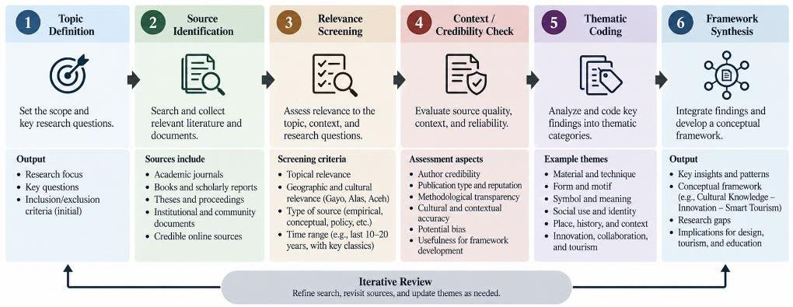
5. Artifact Corpus
Publication-based Gayo Alas jewelry used for material, formal, and contextual analysis
• A01 — Bracelets: silver with suasa accents
• A02 — Triangular hair ornament: silver and suasa
• A03 — Woman’s belt: silver and suasa; linked/mesh construction
• A04 — Grooming set: predominantly silver
• Meanings beyond the published record remain propositions requiring specialist/community validation.
ICADE 2026 | 6

Slide 7
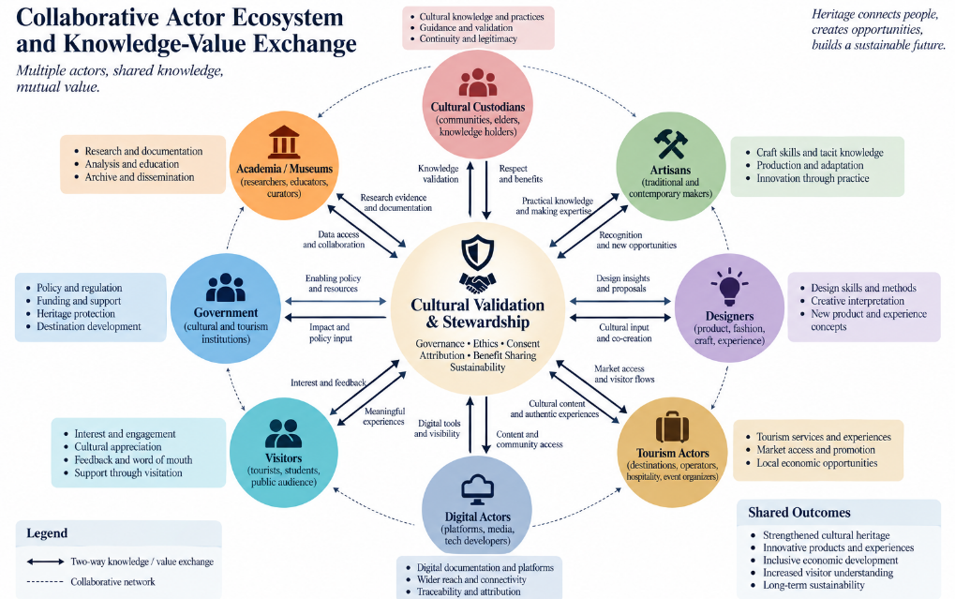
6. Key Result: Repositioning the Innovation Logic
• Commodity logic: artifact → visual extraction → marketable product → cultural story added later.
• Knowledge-resource logic: artifact → documentation → validation → collaborative interpretation → creative translation.
• The shift places cultural context before market or technology deployment.
ICADE 2026 | 7

Slide 8
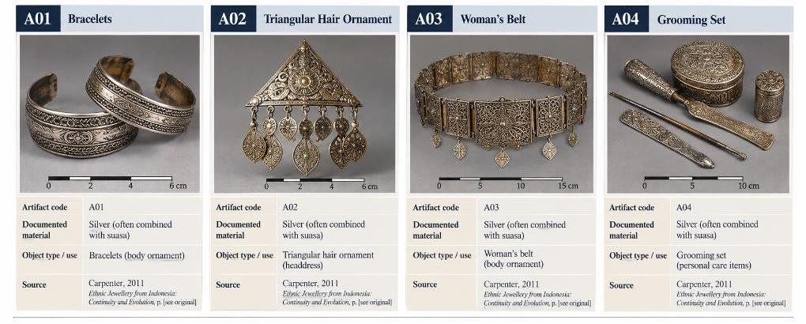
7. Collaboration as Cultural Infrastructure
• Cultural custodians: contextual authority and memory
• Artisans: tacit technical knowledge
• Designers: translation and development methods
• Academia/museums: documentation and source criticism
• Tourism, creative industry, government, digital actors, and visitors complete the ecosystem.
• Validation & Stewardship acts as the governance checkpoint.
ICADE 2026 | 8

Slide 9
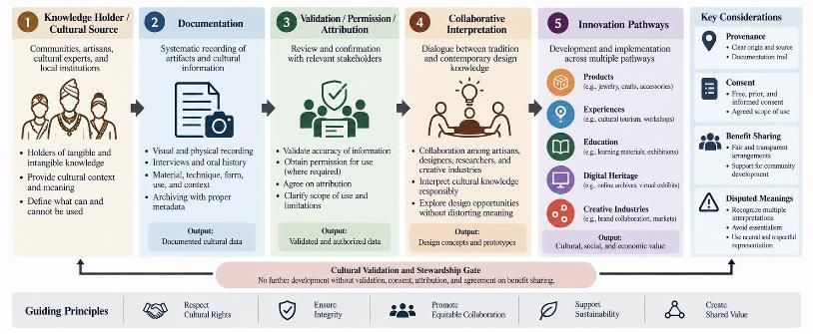
8. Smart Tourism: Technology Around Culture
Technology enables; it does not replace cultural authority
• Documentation & access — catalogues, databases, 3D records
• Interpretation — QR narratives, multimedia, AR/VR
• Collaboration — shared archives and actor connectivity
• Traceability & governance — provenance, permission, attribution
• Primary requirement: cultural accuracy, local capacity, accessibility, and stewardship.
ICADE 2026 | 9

Slide 10
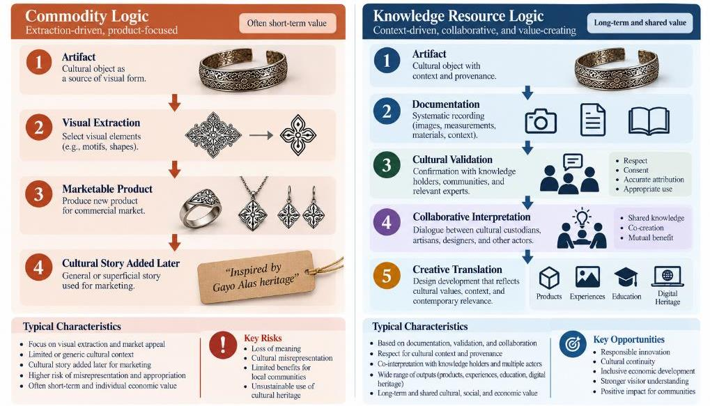
9. Main Contribution
Gayo Alas Cultural Knowledge–Innovation–Smart Tourism Framework
• Core: Cultural Knowledge Resource
• Protective layer: Validation & Stewardship
• Infrastructure: Collaborative Actors
• Pathway: Creative Translation
• Outer enabler: Smart Tourism Technologies
• Outcomes: cultural continuity, responsible innovation, collaborative value, visitor understanding, creative futures
ICADE 2026 | 10

Slide 11
10. Implications for Arts & Design Education
• Treat ethnic jewelry as a cultural knowledge system—not a motif library.
• Learning sequence: Observe → Document → Source Check → Contextualize → Validate → Collaborate → Interpret → Innovate → Reflect.
• Ethical checkpoint is strongest at VALIDATE and COLLABORATE.
• Assessment can include evidence quality, source criticism, cultural validation, collaboration, and reflective judgement.
ICADE 2026 | 11

Slide 12
11. Limitations & Future Research
• Conceptual study based on literature, historical documentation, and a focused four-group publication-based corpus.
• Not a complete contemporary inventory of Gayo or Alas jewelry.
• No new interviews or community validation are reported in the current study.
• Smart-tourism tools are conceptual, not evaluated implementations.
• Next: expand verified artifact corpus; participatory validation; actor mapping/co-design; pilot digital, educational, exhibition, and design pathways.
ICADE 2026 | 12

Slide 13
12. Conclusion
Heritage innovation should begin with cultural knowledge and relationships
Documentation → Cultural Validation → Collaboration → Responsible Creative Translation → Smart Tourism Enablement
• The framework challenges both commodity-first and technology-first development.
• Cultural knowledge is the foundation; technology supports access, interpretation, connectivity, and traceability.
• The proposed model provides a basis for future participatory research, responsible design innovation, cultural tourism, and arts/design education.
ICADE 2026 | 13

Slide 14
Thankyou
Presented by:
Asep Sufyan Muhakik AtamtajaniPutu Raka Setya Putra
Affiliation:
Faculty of Creative Industries, Telkom University, Bandung, Indonesia

