Slide 1
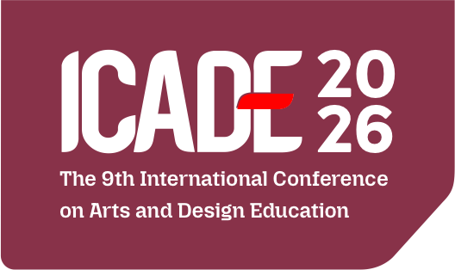

Collaborative Accessory Design through Metal and Dried Flora Integration for Sustainable Tourism Souvenirs
Sustainability, Cultural Heritage, and Creative Futures in Arts Education
Presented by:
Asep Sufyan Muhakik Atamtajani
Fajar Sadika
Affiliation:
Faculty of Creative Industries, Telkom University, Bandung, Indonesia

Slide 2
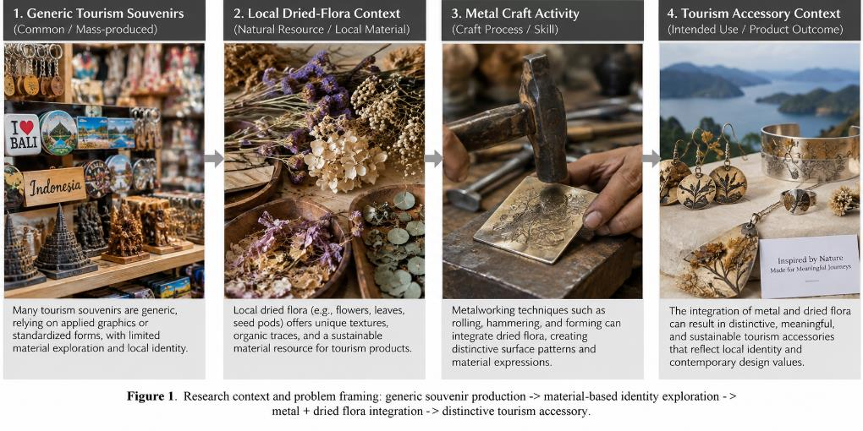
1. Background & Research Problem
Moving beyond generic souvenir graphics toward material-based identity
• Many tourism souvenirs remain generic and communicate place mainly through logos, names, or applied motifs.
• Souvenir identity can also emerge from material origin, transformation, craft process, and product experience.
• This study explores metal + dried flora as a hybrid material strategy for distinctive tourism accessories.
• Core proposition: material transformation itself can become a source of product identity.
ICADE 2026 | 2

Slide 3
2. Research Questions & Contribution
• How can dried flora be integrated with metal through rolling-based experimentation?
• Which material/process variables influence visual quality, stability, manufacturability, and perceived identity?
• How can collaborative evaluation translate experimental outcomes into tourism-oriented accessories?
• Contribution: transferable design principles and a Metal–Dried Flora Collaborative Design Framework.
ICADE 2026 | 3

Slide 4
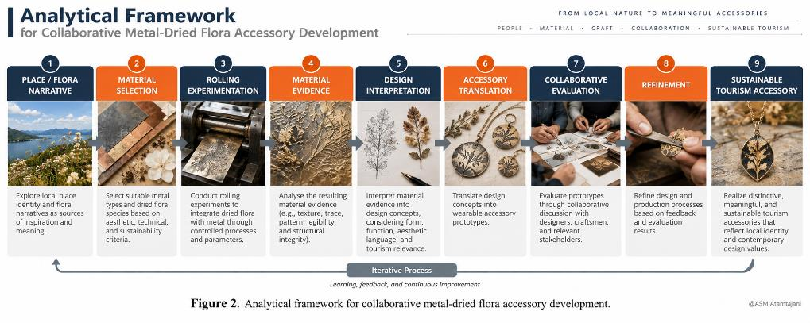
3. Analytical Framework
Material narrative → experimentation → evidence → product translation
ICADE 2026 | 4

Slide 5
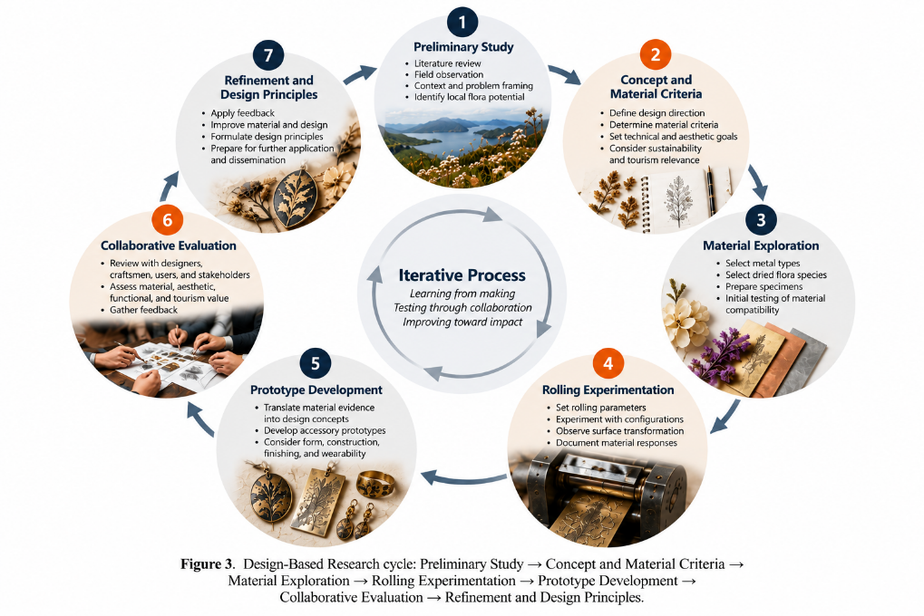
4. Methodology
Design-Based Research (DBR) in a jewelry-workshop context
• Location: Medividi Studio, Bandung; six-month study.
• 13 participants: researcher/product designer, 5 metal craftspeople, 2 jewelry makers, 1 studio owner/designer, and 4 university students.
• Materials: brass and silver sheets (approx. 0.5–0.8 mm) with daffodil, iris, cosmos, and orchid.
• Iterative cycle: exploration → rolling → prototype → collaborative evaluation → refinement.
ICADE 2026 | 5

Slide 6
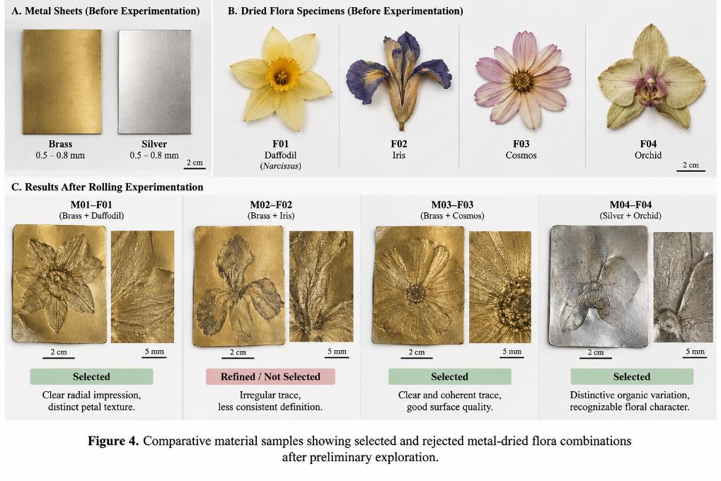
5. Material Exploration
Floral morphology strongly influenced botanical-trace legibility
• Daffodil: recognizable radial impression; thickness affected trace definition.
• Iris: irregular, layered organic impressions; less consistent legibility.
• Cosmos: clearer and more coherent radial trace; promising for prototypes.
• Orchid: distinctive organic variation; required careful positioning.
• Selection considered both clarity and expressive irregularity.
ICADE 2026 | 6

Slide 7
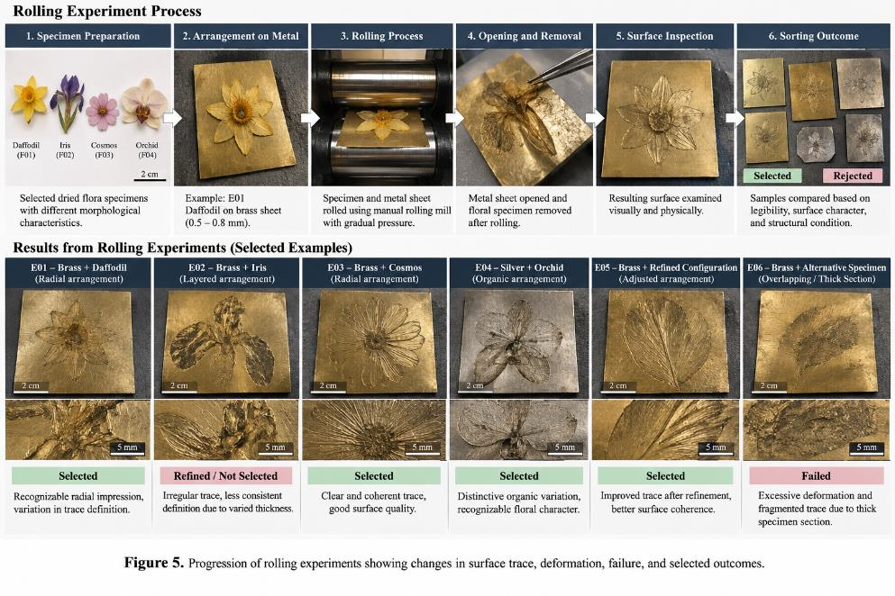
6. Rolling Experiments & Material Transformation
• Rolling was treated as an exploratory design variable, not a fixed production recipe.
• Key variables: metal type/thickness, floral morphology, specimen thickness, arrangement, orientation, and practical rolling condition.
• Failures—weak transfer, deformation, fragmented traces—were retained as design evidence.
• Best outcomes balanced botanical legibility, surface character, and metal integrity.
ICADE 2026 | 7

Slide 8
7. Key Finding: Organic Trace as Material Evidence
• Botanical traces emerged directly from physical interaction between dried flora and metal—not from engraving, printing, or applied decoration.
• Natural irregularity became part of the aesthetic vocabulary when it did not compromise product integrity.
• The dried flora therefore functioned as an active material agent in generating surface structure.
• Material evidence became the starting point for composition, scale, form, and accessory typology.
ICADE 2026 | 8

Slide 9
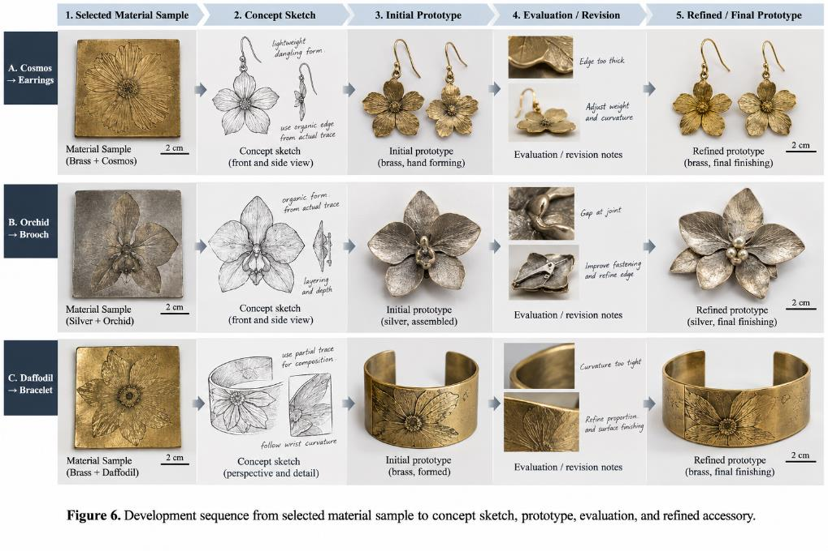
8. From Material Evidence to Accessory Prototype
• Developed typologies included necklaces, bracelets, brooches, earrings, and rings.
• Prototype form responded to trace orientation, relief, visual density, structural condition, and body placement.
• Fabrication preserved botanical evidence through cutting, forming, joining, finishing, and polishing.
• Strongest prototypes integrated botanical trace, metal surface, form, and construction as one composition.
ICADE 2026 | 9

Slide 10
9. Collaborative Evaluation
Balancing expression, feasibility, wearability, and tourism relevance
• Material legibility — preserve the strongest botanical evidence.
• Aesthetic coherence — surface and product form should appear integrated.
• Manufacturability — experimental surfaces must remain compatible with jewelry production.
• Wearability — refine curvature, edges, weight, fastening, and body contact.
• Tourism relevance — retain a clear flora–material–craft narrative that differentiates the product from generic souvenirs.
ICADE 2026 | 10

Slide 11
10. Five Design Principles
• 1. Select flora through both contextual relevance and material potential.
• 2. Treat material–process interaction as a design variable.
• 3. Preserve natural irregularity while maintaining product integrity.
• 4. Translate material evidence into product form.
• 5. Use collaborative evaluation to balance expression, feasibility, and contextual meaning.
ICADE 2026 | 11

Slide 12
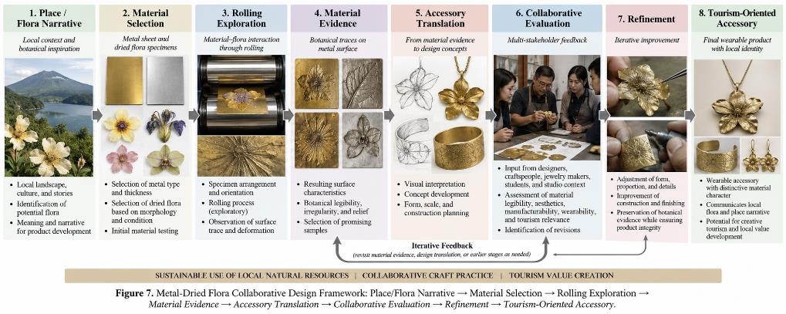
11. Main Contribution
Metal–Dried Flora Collaborative Design Framework
ICADE 2026 | 12

Slide 13
12. Discussion & Implications
• Tourism-product identity can be materially generated rather than exclusively symbolically applied.
• Natural irregularity has design value, but it requires control to maintain structural integrity, finishing, safety, and wearability.
• Workshop experimentation becomes design knowledge when material input, response, interpretation, and next decisions are documented.
• Collaborative evaluation integrates tacit craft knowledge with design interpretation.
• Creative-tourism applications are promising—demonstrations, material storytelling, and participatory workshops—but were not directly tested.
ICADE 2026 | 13

Slide 14
13. Limitations & Future Research
• Limited metals and dried-flora configurations; findings are exploratory design insights, not universal technical specifications.
• Rolling pressure, gap, and passes were not standardized quantitatively.
• Long-term durability and formal environmental/LCA performance were not tested.
• Participant evaluation does not represent broader tourist or consumer preferences.
• Future work: controlled process testing, durability/LCA, tourist-user evaluation, place-specific flora provenance, and creative-tourism pilots.
ICADE 2026 | 14

Slide 15
14. Conclusion
Material and process become active contributors to product meaning
Place / Flora Narrative → Material Selection → Rolling → Material Evidence → Accessory Translation → Evaluation → Refinement → Tourism Accessory
• Dried flora can generate distinctive traces and surface character through direct physical transformation of metal.
• Both successful and unsuccessful trials contribute to iterative design knowledge.
• The central contribution is a framework in which material evidence connects experimentation with tourism-oriented product identity.
ICADE 2026 | 15

Slide 16
Thankyou
Presented by:
Asep Sufyan Muhakik Atamtajani
Fajar Sadika
Affiliation:
Faculty of Creative Industries, Telkom University, Bandung, Indonesia

