Slide 1


Verbal Instruction in Choral Rehearsals
A Scoping Review of the Translation of Musical Concepts
Presented by:
Brigita Prilinggar Kinanti
Affiliation:
Universitas Pendidikan Indonesia
Indonesia

Slide 2
Background & Research Gap
Background
Choral rehearsal is a communication process
Choral conductors use verbal instruction to help singers achieve musical goals.
Musical concepts are often abstract and difficult to apply directly.
Research Gap
Previous research mainly discuss verbal instruction through separate aspects, such as rehearsal interaction, feedback, vocal pedagogy, and conducting competence.
Few studies explain how verbal instruction translates musical concepts into singers’ understanding and singing actions.
Presented by:
Brigita Prilinggar Kinanti
Affiliation:
Universitas Pendidikan Indonesia
Indonesia

Slide 3
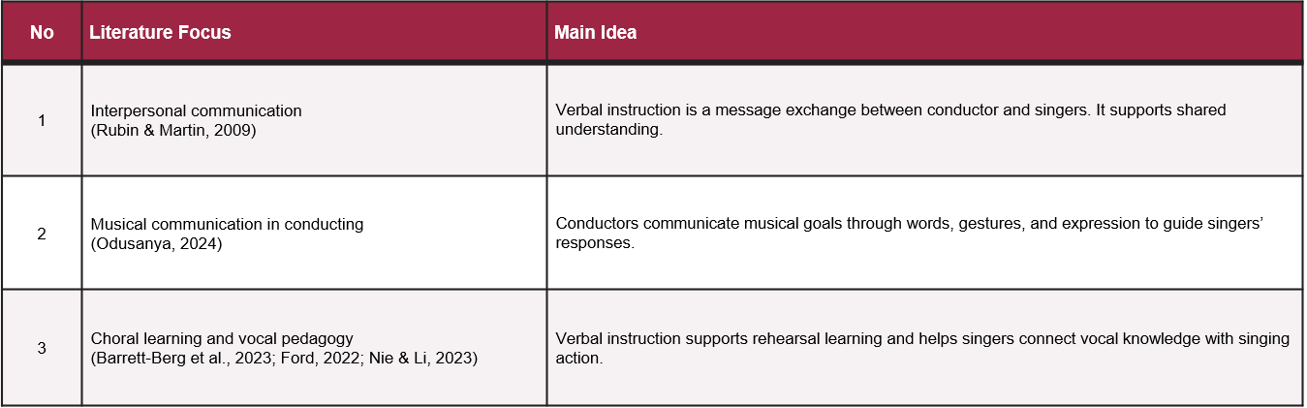
Literature Review
Presented by:
Brigita Prilinggar Kinanti
Affiliation:
Universitas Pendidikan Indonesia
Indonesia

Slide 4
Research Objective & Method
Objective
To analyze and synthesize previous research on verbal instruction in choral conducting, especially how it helps singers understand and apply musical concepts.
Method
Scoping Review
Approach : Descriptive qualitative
Framework : Population–Concept–Context (PCC)
Data Sources: ScienceDirect, Taylor & Francis Online, SAGE Journals, and Google Scholar
Analysis : Thematic analysis
Presented by:
Brigita Prilinggar Kinanti
Affiliation:
Universitas Pendidikan Indonesia
Indonesia

Slide 5
Verbal Instruction as a Musical Translation Process
Analytical Framework
Musical Goal
(Choral Conductor’s Musical Intention)
Verbal Instruction
(Language, Explanation, Feedback)
Singer Understanding
(Interpretation of Musical Meaning)
Singing Practice
(Vocal Response & Musical Expression)
Affiliation:
Universitas Pendidikan Indonesia
Indonesia
Presented by:
Brigita Prilinggar Kinanti
Sound Result

Slide 6
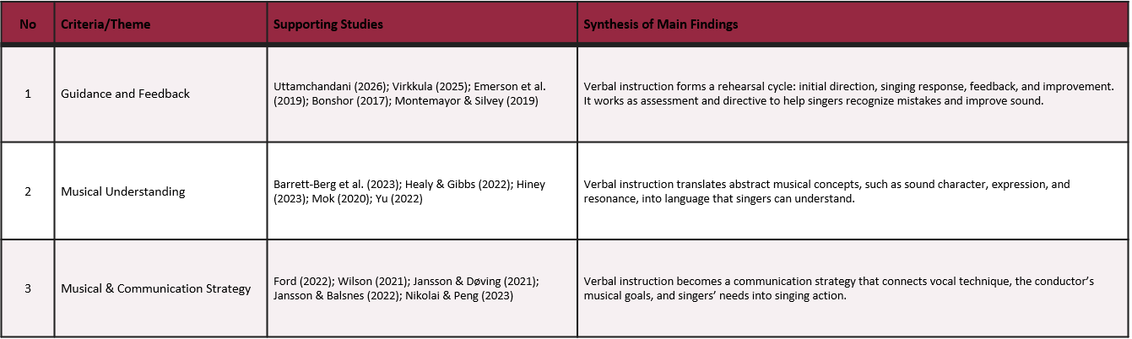
Previous Research Analyzed
Table 1. Characteristics of the Previous Studies Analyzed
Presented by:
Brigita Prilinggar Kinanti
Affiliation:
Universitas Pendidikan Indonesia
Indonesia

Slide 7
Main Findings
1. Guidance and Feedback
Verbal instruction helps singers improve performance through direction, evaluation, and correction.
It creates a rehearsal cycle: instruction - singing response - feedback - improvement.
2. Musical Understanding
Verbal instruction helps singers understand abstract musical concepts, such as sound character, expression, and resonance.
Translates abstract musical concepts into understandable language.
3. Musical and Communication Competence
Verbal instruction connects the choral conductor’s musical goals with singers’ understanding and singing actions.
Presented by:
Brigita Prilinggar Kinanti
Affiliation:
Universitas Pendidikan Indonesia
Indonesia

Slide 8
Conclusion
Verbal Instruction in Choral Rehearsal
Verbal instruction is not only used for correction, but also functions as a musical communication strategy.
It helps translate abstract musical concepts into understandable actions through
musical goals - verbal instruction - singer understanding - singing practice.
This study highlights that effective verbal instruction connects the choral conductor’s intention with singers’ musical performance.
Future Research
Future research could examine interactions during choir rehearsals through direct observation and interviews.
Presented by:
Brigita Prilinggar Kinanti
Affiliation:
Universitas Pendidikan Indonesia
Indonesia

Slide 9
Thank you
Presented by:
Brigita Prilinggar Kinanti
Affiliation:
Universitas Pendidikan Indonesia
Indonesia

