Slide 1


Collaborative Music Practices to Foster Humanities Values in Generation Alpha
Internalizing social-emotional skills and empathy through school ensemble learning
Presented by:
Mega Alifah Purnama Bawole
Affiliation:
Indonesia University of Education
Indonesia

Slide 2
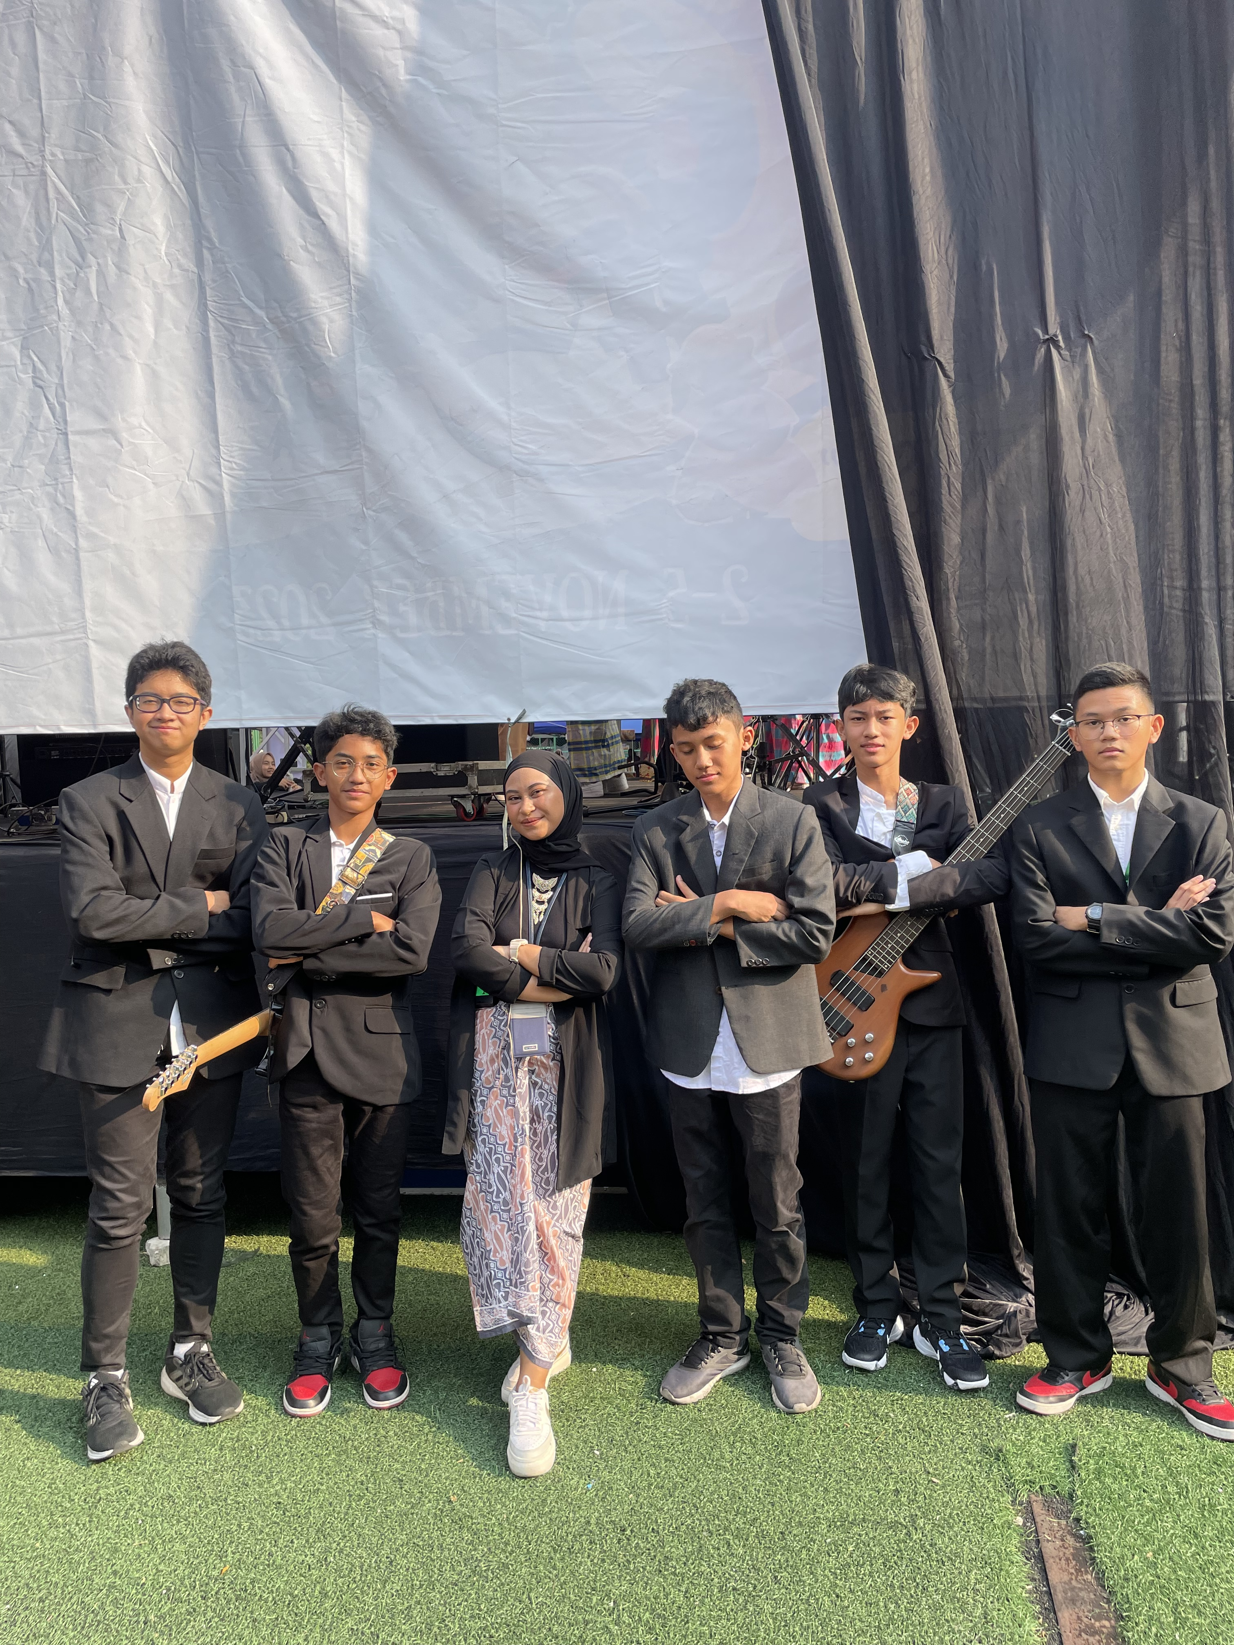
01. BACKGROUND & PROBLEM
The Generation Alpha Empathy Challenge
Rapid Digital Advancement
Gen Alpha grows up immersed in digital technology, altering social interaction patterns.
Social-Emotional Vulnerability
Screen-dominated communication risks weakening interpersonal empathy and social sensitivity.
Character Development Imperative
Arts education must proactively instantiate humanistic values into daily school learning.

Slide 3



02. PROPOSED SOLUTION & THEORETICAL FRAMEWORK
Collaborative Music Practice as Humanistic Medium
Interactive Social Space
Group ensemble activities establish a real-world platform for intensive social interaction.
Acoustic & Tone Harmony
Train active mutual listening & nonverbal communication to synchronize sound.
Humanities & SEL Theory
Grounded in Humanistic Eduaction & Social-Emotional Learning (SEL) frameworks.

Slide 4
03. RESEARCH METHODOLOGY
Qualitative Case Study & SLR Design
Dual-Method Strategy
Combines qualitative Case Study with Systematic Literature Review (SLR).
SMP Labschool Cirendeu
Gen Alpha students (Grades 7-9) and music educators in active classroom practice.
RESEARCH APPROACH
SUBJECTS & CONTEXT
Observation : Participatory classroom tracking
Interviews : In-depth teacher & student sessions
Documents : Curriculum & lesson plan analysis
Structured data reduction, systematic visual presentation, and inductive conclusion drawing.
DATA COLLECTION TRIANGULATION
DATA ANALYSIS FLOW

Slide 5
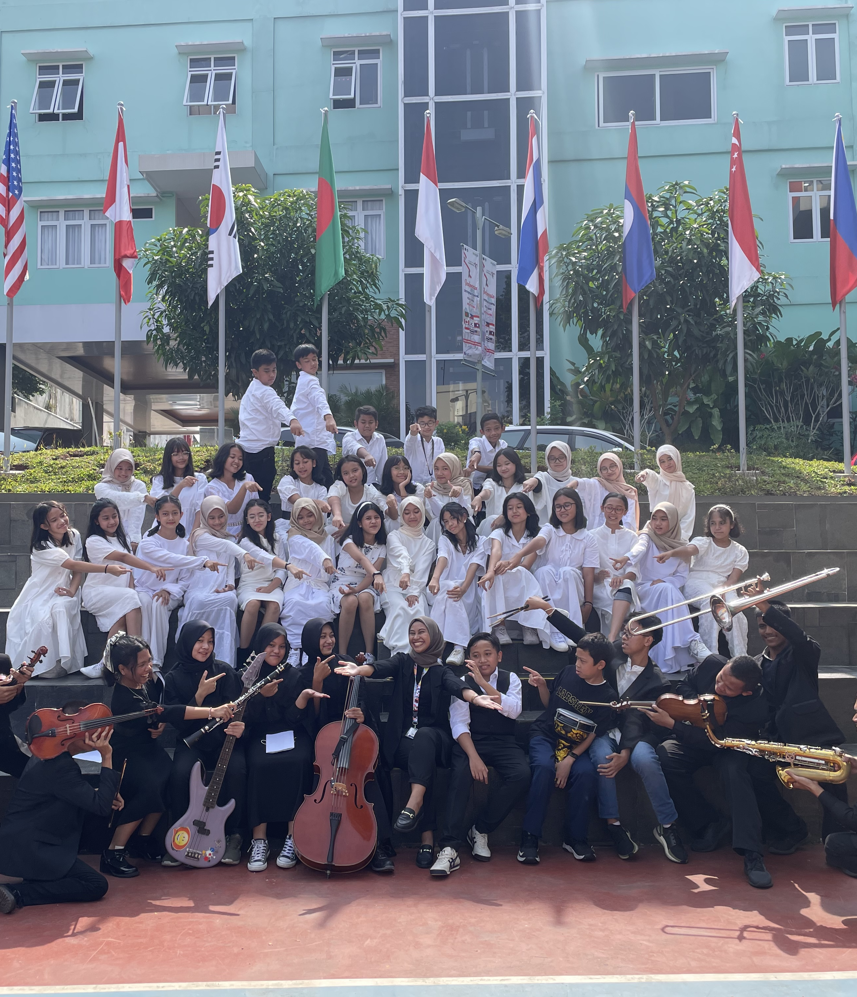
04. KEY RESEARCH RESULTS
Internalizing Humanities Values Through Ensemble
1. Empathy Cultivation
Listening to peers in ensemble builds active empathy and mutual respect.
2. Emotional Regulation
Harmonizing tones reinforces sel-control and collective patience.
3. Behavioral Habituation
Sensitivity progresses from introductory practice into positive school habits.

Slide 6
05. CONCLUSION & ACADEMIC CONTRIBUTIONS
Transforming Generation Alpha Education Through Music
Core Conclusion
Collaborative music practice offers an effective nonverbal pathway to install deep humanistic values and empathy.
Pedagogical Contribution
Provides a replicable model for arts curricula to balance digital advancement with character building.

Slide 7
Thankyou
Presented by:
Mega Alifah Purnama Bawole
Affiliation:
Indonesia University of Education
Indonesia

