Slide 1


Analysis of Cultural Values in the Traditional Game of Jajangkungan:
Critical Literature Review
Presented by:
Amany Adeannisa
Affiliation:
Arts Education Study Program, Faculty of Master Degree,
Indonesia University of Education, Bandung, Indonesia

Slide 2
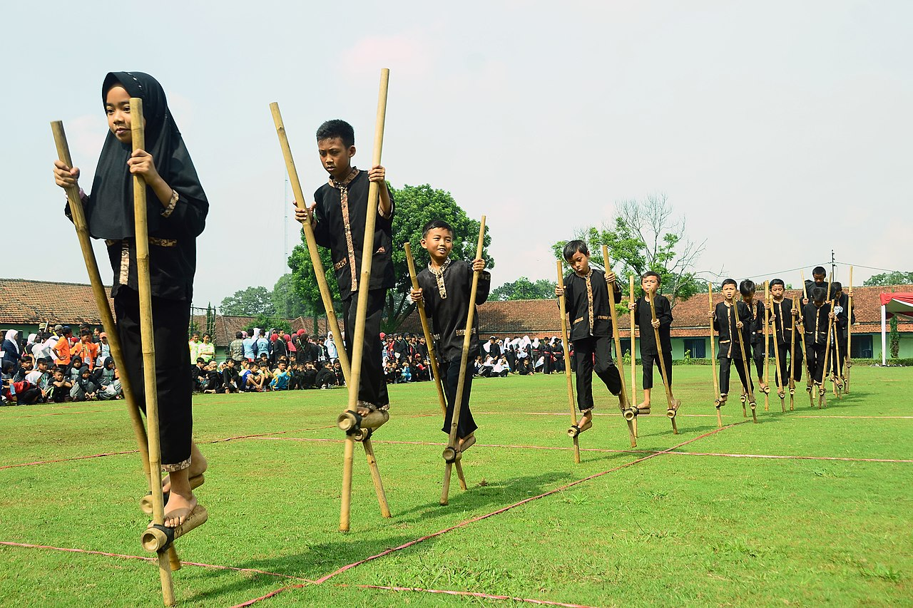
Background
Traditional games are a cultural heritage passed down through generations, embodying social, educational, and local wisdom values.
The digital era has reducing children's interest toward smartphones and social media, yet has not erased its unique appeal.
Previous research has mainly examined motoric skill, socio-emotional, and character benefits grounded in local philosophy.
Benefits keep expanding: physical literacy, public health, reduced device addiction, and contributions to the character-building agenda across social, economic, and environmental dimensions.
Source: Bamboo Stilt (Egrang) Game, a Traditional Indonesian Children's Game
Analysis of Cultural Values in the Traditional Game of Jajangkungan: Critical Literature Review
2

Slide 3
Problem Statement and Research Novelty
Previous Research Landscape
Novelty of This Study
Most studies frame traditional games merely in terms of physical or psychological function.
Little attention has been paid to the link between physical-motor development and the instilling of cultural values.
The cultural values embedded in the materials, gameplay, and symbolic meaning of Jajangkungan (Sundanese stilts) remain understudied.
Maps the integration of Jajangkungan's cultural values using Huxley's cultural component framework (artefacts, mentifacts, sociofacts).
Unites perspectives on social cultural values and ethnic-cultural language.
Affirms Jajangkungan's position as a medium for national character education, not merely physical amusement.
Analysis of Cultural Values in the Traditional Game of Jajangkungan: Critical Literature Review
3

Slide 4
Literature Review
No. | Reference | Conclusion
1 | Rahmat, A. D., Wilujeng, I., & Kuswanto, H. (2023). Journal of Science Learning, 6(4), 435–441. | The MOLERAVA mobile-learning app built on an Egrang mini-game significantly improved junior-high students' multiple-representation skills in physics compared with textbook instruction; Egrang is framed as West Javanese local wisdom reflecting balance and physical agility.
2 | Fitri, M., Nur, H. A., & Putri, W. (2020). Frontiers in Psychology, 11, 587196. | Jajangkungan/Egrang, first popularized in West Java, carries values of balance and courage in its physical practice, and social harmony and cultural identity in its communal staging during Independence Day celebrations.
3 | Luchoro-Parrilla, R., et al. (2021). Frontiers in Psychology, 12, 586238. | A game's internal structure (rules, objects, interactions) can be read as an expression of its surrounding culture, based on an ethnomotor analysis of 513 Canary Islands traditional games.
4 | García-Monge, A., Rodríguez-Navarro, H., & Bores-García, D. (2021). Frontiers in Psychology, 12, 676590. | Traditional games act as vehicles of symbolic enculturation, transmitting embedded cultural values to children even without formal instruction.
5 | Dwimagistri Sukmana, E., et al. (2025). Retos, 69, 1278–1294. | The terminology of Indonesian traditional sports carries cultural meaning, providing an ethnolinguistic basis for reading local vocabulary as a carrier of heritage.
Analysis of Cultural Values in the Traditional Game of Jajangkungan: Critical Literature Review
3

Slide 5
Research Method: Critical Literature Review (CLR)
1
→
2
→
3
→
4
Database Search
Selection Criteria
Data Reduction
In-Depth Critical Analysis
Search articles in Scopus using the keywords: traditional game, cultural value, Jajangkungan, egrang, children development, ethnomotricity (2020–2026).
Inclusion: articles discussing traditional games and jajangkungan.
Exclusion: articles with incomplete DOIs.
The selection process yielded 37 scopus international articles.
The articles were reviewed using a 4-pillar comparison matrix: research gap & novelty, focus & problem statement, methodological strengths/weaknesses, and state of the art.
Analysis of Cultural Values in the Traditional Game of Jajangkungan: Critical Literature Review
4

Slide 6
Cultural Value Synthesis: Huxley's Framework
Table 1. Manifestation of Cultural and Character Values in the Jajangkungan Game
Cultural Dimension | Manifestation in Jajangkungan | Cultural & Character Values
Artefacts (Material Artefacts) | Bamboo, sized cutting, and construction of footrests without synthetic materials. | Simplicity, ecological local wisdom, and sustainable use of natural resources.
Mentifacts (Cognitive & Mental) | Rules for maintaining dynamic balance at height, estimating motor coordination, and adapting body movement. | Courage, perseverance, mental resilience (recovering from falls), focus, and life balance.
Sociofacts (Socio-Cultural) | Interaction while competing/playing together, mutual support, and agreeing on shared rules of play. | Social harmony, peace-loving values, community togetherness, and mutual respect.
Analysis of Cultural Values in the Traditional Game of Jajangkungan: Critical Literature Review
5

Slide 7
Critical Discussion: Research Novelty
The critical synthesis highlights a common pattern that separates the functional-sporting domain from cultural ethnography. This study positions Jajangkungan as a medium for reintroducing traditional games through the integration of the following three pillars:
Ethnolinguistics
Peace-Loving Character
Sustainable Ecology
Preservation of local cultural-heritage terminology and vocabulary.
Instilling values of peace through the interaction of playing together.
A framework for the sustainable use of natural resources.
Analysis of Cultural Values in the Traditional Game of Jajangkungan: Critical Literature Review
6

Slide 8
Conclusion
Traditional games are a heritage passed down through generations that is increasingly being replaced by digital media activities. These games are not only about fun, but also serve as education in cultural values.
The traditional Jajangkungan game holds a range of cultural values, offering a practical step toward preserving local cultural heritage while also helping reduce addiction to smartphones and social media.
In the future, recommended doing Field Research Qualitative-Experimental at West Java, in order documentation the practice of Jajangkungan as visually and empirically, and test the real impact on children’s character development.
Analysis of Cultural Values in the Traditional Game of Jajangkungan: Critical Literature Review
7

Slide 9
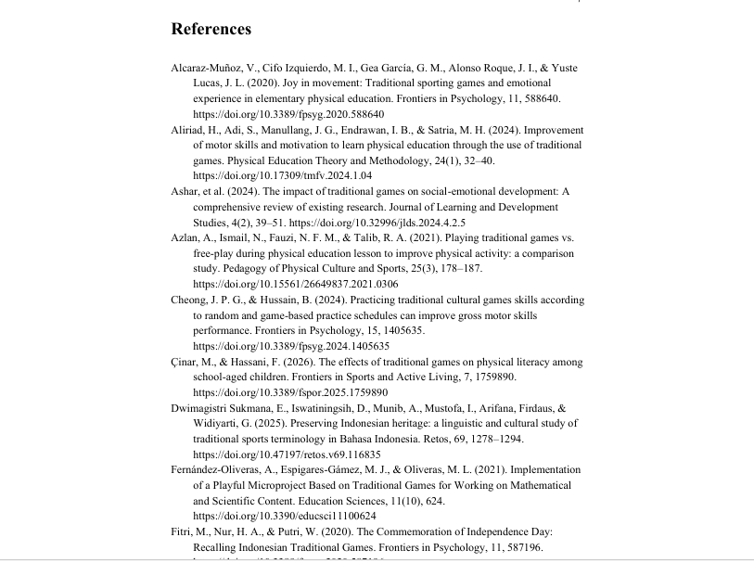
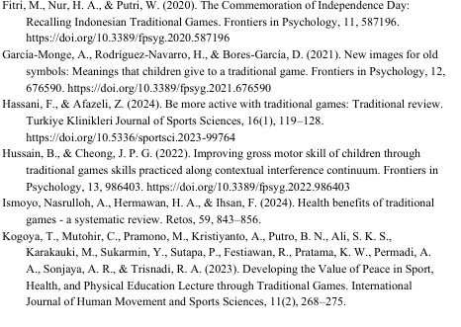
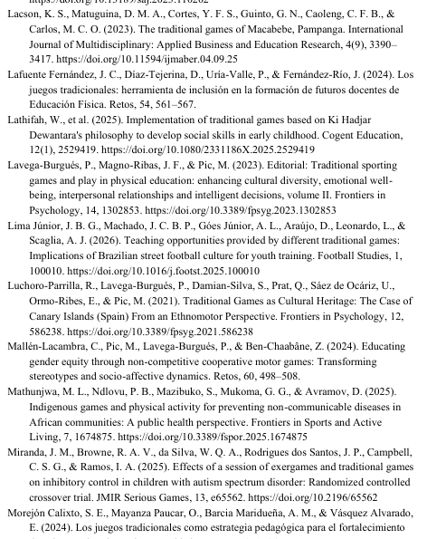
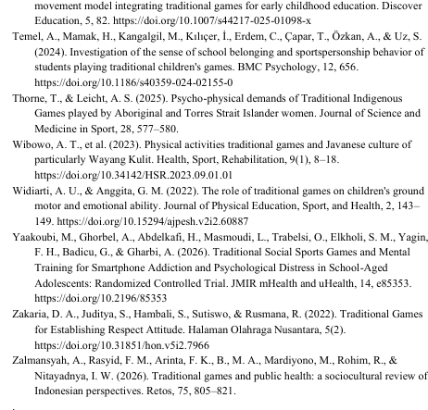
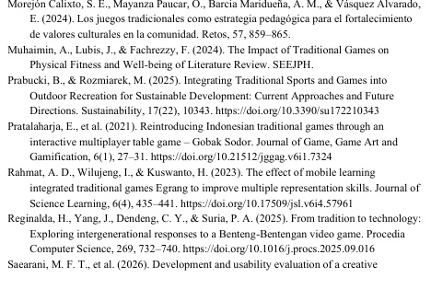
Reference
Analysis of Cultural Values in the Traditional Game of Jajangkungan: Critical Literature Review

Slide 10
Thank You
Presented by:
Amany Adeannisa
aadeannisa@upi.edu
Affiliation:
Arts Education Study Program, Faculty of Master Degree,
Indonesia University of Education, Bandung, Indonesia

