Slide 1


DIGITAL LITERACY IN ART LEARNING AT ONE-ROOF JUNIOR HIGH SCHOOLS
Digital media enables interactive learning, critical thinking, and student creativity.
Presented by:
Ratu Siska Janevita * Juju Masunah * Reni Haerani
Affiliation:
Universitas Pendidikan Indonesia
Bandung, Indonesia

Slide 2
BACKGROUND
The development of digital technology has changed the way teachers and students obtain, process, and produce information.
Art learning has the potential to develop critical thinking, creativity, expression, appreciation, and digital communication skills.
The use of digital technology in art learning in one-roof schools has not been optimal.
Students not only need the ability to use digital devices, but also the ability to choose information, understand sources, create works, and use technology responsibly.

Slide 3
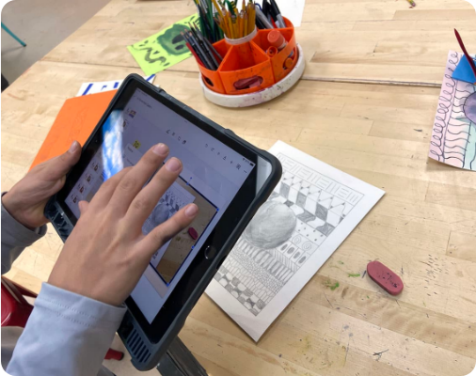
PROBLEM
How can digital literacy be integrated into art learning at the junior high school level in One-Roof Schools to support students' creativity and competence?

Slide 4
SOLUTION- THEORETICAL BASIS
(Literacy Theory, 21st Century Skills, TPACK, Contextual, Technology-Based Art Learning)
.
Improving teachers' competence in the use of technology for art learning
Integrating digital technology into the art learning process
Improving students' ability to choose and evaluate digital information.
Utilizing videos, images, learning platforms, and digital resources as learning media.
Encourage creativity and collaboration through digital media.

Slide 5
RESEARCH METHOD
(Descriptive analysis method with a qualitative approach)
Identify the problem
Data collection
Analysis
Implementation/
Result
Conclusions

Slide 6
RESULTS
Improvement of Teacher competence in learning digitalizatio
Improvement in student engagement
Improvement of digital literacy skills
Development of creativity
Strengthening of arts education

Slide 7
CONCLUSION& CONTRIBUTION
The success of the implementation of digital literacy is influenced by teacher competence, readiness, availability of facilities, and support of the school environment.
The integration of digital literacy in art learning at the junior high school level in a one-roof school can be a strategy to strengthen a creative, contextual, and appropriate learning experience in accordance with the development of the students' digital environment
Art learning is not only oriented to the ability to produce works, but also develops students' ability to access, evaluate, use, create, and communicate information through digital technology responsibly.

Slide 8

Image Source:
theartofeducation.edu
https://theartofeducation.edu/wp-content/uploads/2026/01/IMG_9077.jpg

Slide 9
Thankyou
Presented by:
Ratu Siska Janevita *Juju Masunah *Reni Haerani
Affiliation:
Universitas Pendidikan Indonesia
Bandung, Indonesia

