Slide 1
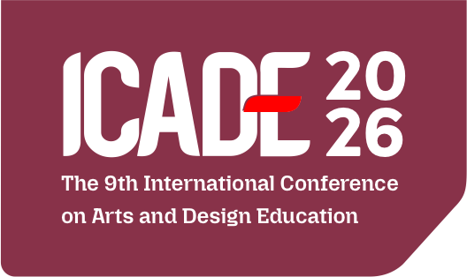

EXPLORATION OF PAINTING BASED ON THE IDEA OF CAKRA RAHAYU KENCANA
Presented by:
Rifa Jahid Hanafi
Affiliation:
Universitas Pendidikan Indonesia
Indonesia

Slide 2
PAINTING EDUCATION IN SCHOOLS HAS THE POTENTIAL TO BE DEVELOPED THROUGH THE USE THE OF LOCAL CULTURE AS A SOURCE OF IDEAS FOR ARTISTIC CREATION. CAKRA RAHAYU KENCANA IS ONE OF THE LOCAL CULTURAL SYMBOLS SERVE AS A SOURCE OF INSPIRATION FOR EXPLORING PAINTING.
Presented by:
Rifa Jahid Hanafi
Affiliation:
Universitas Pendidikan Indonesia
Indonesia

Slide 3
THIS EXPOLARITION IS NOT MERELY DIRECTED TOWARD IMITATING ITS VISUAL FORM, BUT ALSO INVOLVES OBSERVING, EXPLORING, INTERPRETING AND TRANSFORMING VISUAL ELEMENTS AND CULTURAL VALUES INTO PAINTINGS.
THIS STUDY AIMS TO DESCRIBE THE PROCESS OF PAINTING EXPLORATION BASED ON THE IDEA OF CAKRA RAHAYU KENCANA AND TO IDENTIFY THE TRANSFORMATION OF VISUAL ELEMENTS AND CULTURAL VALUES INTO STUDENTS ARTWORKS.
Presented by:
Rifa Jahid Hanafi
Affiliation:
Universitas Pendidikan Indonesia
Indonesia

Slide 4
THIS STUDY EMPLOYED A DESCRIPTIVE METHOD WITH A QUALITATIVE APPROACH.
DATA WERE COLLECTED THROUGH OBSERVATION, INTERVIEWS, DOCUMENTATION AND ANALYSIS OF STUDENTS ARTWORKS
DATA WERE ANALYZED USING THE MILES, HUBERMAN AND SALDANA MODEL, WHICH CONSISTS OF DATA CONDENSATION, DATA DISPLAY, AND CONCLUSION DRAWING AND VERIFICATION
Presented by:
Rifa Jahid Hanafi
Affiliation:
Universitas Pendidikan Indonesia
Indonesia

Slide 5
THE FINDINGS INDICATE THAT CAKRA RAHAYU KENCANA CAN SERVE AS A CONTEXTUAL SOURCE OF IDEAS FOR PAINTING EXPLORATION. THE EXPLORATION PROCESS INVOLVED SEVERAL STAGES, INCLUDING OBSERVING VISUAL FORMS AND ELEMENTS, UNDERSTANDING SYMBOLIC MEANINGS AND CULTURAL VALUES, DEVELOPING IDEAS AND TRANSFORMING THESE ELEMENTS INTO DIVERSE VISUAL FORMS.
Presented by:
Rifa Jahid Hanafi
Affiliation:
Universitas Pendidikan Indonesia
Indonesia

Slide 6
THE STUDENTS ARTWORKS DEMONSTRATED VARIATIONS IN THE USE FORMS, LINE, COLORS, COMPOSITION, SYMBOLS AND VISUAL STYLES.
THS PROCESS PROVIDED STUDENTS WITH OPPORTUNITIES TO DEVELOP THEIR IDEAS AND PERSONAL EXPRESSIONS WHILE SIMULTANEOUSLY RECOGNIZING AND APPRECIATING LOCAL CULTURE THROUGH THE CREATION OF PAINTINGS.
Presented by:
Rifa Jahid Hanafi
Affiliation:
Universitas Pendidikan Indonesia
Indonesia

Slide 7
Thankyou
Presented by:
Rifa Jahid Hanafi
Affiliation:
Universitas Pendidikan Indonesia
Indonesia

