Slide 1


Development of a Three-Wheeled Waste Collection Container to Enhance Operational Effectiveness and Efficiency User
Presentation Title
Subtitle or Research Focus
Presented by:
Alvian Fajar Setiawan
Andrianto
Divani Nazhivah
Affiliation:
Telkom University
Indonesia
Affiliation:
Institution / University
Country

Slide 2

introduction
Case Study in Padasuka Urban Village
198,180 Ha
42.402 people
Central Cimahi District • Cimahi City
ISSUES
01
Tub material
02
No sorting has been done yet.
03
Spilled waste and liquids
04
Staff workload
The material is susceptible to corrosion, potentially compromising the quality and service life of the tank.
There is no organic-inorganic compartment, resulting in suboptimal sorting.
The cover is not optimal; waste can scatter, and liquid drips onto the road, causing odors.
Personnel still require additional manpower for the manual collection and compaction of waste.
Development Direction
Developing bins made from more corrosion-resistant materials that feature waste separation and optimized lids, while also supporting transport efficiency and reducing the physical strain on sanitation workers.

Slide 3
Design basis for the three-wheeled motorcycle waste bin in Padasuka Urban Village.
PREVIOUS RESEARCH
THEORETICAL BASIS
Shabirin et al. (2023)
Design Thinking • ergonomics • safety • lightweight & impact-resistant materials
1
Design
A systematic process based on problems and needs
Three-wheeled vehicle • automatic waste lifting • reduces direct contact for personnel
2
Waste transportation
Enclosed cargo bed, cars/trucks, and three-wheeled vehicles
IRJET (2019)
3
Ergonomics & anthropometry
Comfort, posture, injury risk, body dimensions
Pratama (2022)
Demand for three-wheeled cargo motorcycles • quantitative approach • collection efficiency
4
Material
Fiberglass, iron, ABS, and wood
RESEARCH POSITION
Design of a three-wheeled motorcycle cargo bed made of fiberglass that is stronger, corrosion-resistant, and tailored to user needs.
5
UCD
User needs and characteristics as the basis for design
MATERIAL FOCUS
Fiberglass: lightweight • strong • corrosion-resistant • relatively affordable

Slide 4
Field Assessment & Design Requirements
Sorting
The collection vehicle lacks separate compartments for organic, inorganic, and hazardous (B3) waste. Waste that has been sorted at home gets mixed together again during transport.
Time at the polling station
Re-sorting takes approximately one hour for 2–3 motorcycles, resulting in vehicle queues at the temporary waste collection site.
Corrosion
Iron tanks are prone to corrosion; replacement or maintenance is carried out approximately every two years.
Staff workload
Workers are still compacting waste manually and need a solution to reduce the number of transport trips.
4 PRIMARY NEEDS
1
Separation
2
Corrosion-resistant
3
Work efficiency
4
Ergonomics
Design direction: fiberglass tub + sorting partitions + ergonomic + supports transport efficiency

Slide 5
METHOD
Research design, data gathering, and User-Centered Design (UCD) approach
1. RESEARCH DESIGN
Qualitative
Case study
Objective
Understanding user behaviors, experiences,
needs, and pain points.
Location: Padasuka Urban Village,
Cimahi City.
Developing a three-wheeled motorized garbage bin that is more damage-resistant and improves operator performance.
2. DATA COLLECTION TECHNIQUES
Observation
Interview
Existing Product
01
02
03
Observing the activities of sanitation workers for a day.
The Padasuka Urban Village Secretary, to explore issues regarding waste management.
Observing the sanitation vehicles used in the Padasuka area.

Slide 6
Design & Validation Process
User-Centered Design (UCD) → user needs → prototype → evaluation
3. FOUR STAGES OF UCD
01
Understand
Context of Use
02
Specify User
Requirements
03
Design
Solutions
04
Evaluate Against
Requirements
Understanding usage conditions through field observation.
Identify user needs and problems.
Brainstorming, alternative solutions, and prototype development.
Prototype testing, feedback, and design improvements.
4. EIGHT STAGES OF PRODUCT DESIGN
1
Analysis of similar products
2
User needs analysis
3
Ideation
4
Alternative
sketch
5
Orthogonal view
6
3D
modelling
7
Prototyping
fiberglass
8
Evaluation &
Improvement

Slide 7
DEVELOPMENT OUTCOMES
Analysis of user needs and design concept for a three-wheeled motorcycle garbage bin
1. USER PROFILE & BEHAVIOR
30–50
5×/minggu
07.00–12.00
Years old
transport frequency
observation period
TEMUAN OBSERVASI
07.00
The tank is still empty.
10.00
Seepage of fluid began to be detected.
11.00
Bin nearly full; organic and inorganic waste mixed together.
12.00
Transportation complete
2. DESIGN REQUIREMENTS
1
Retaining leachate / waste liquid
2
Strong & corrosion-resistant
3
Easy to clean
4
Organic–inorganic–hazardous waste segregation
Easier access for waste entry and exit.
5
CONCEPT
Trapezoidal • yellow • fiberglass • sorting partition • drainage • easy access

Slide 8
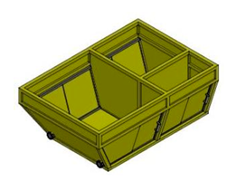
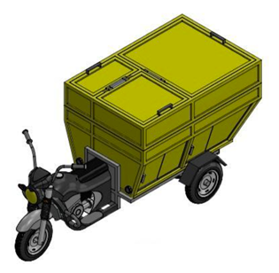
1
Mind map
2
Moodboard
3
Blocking system
Solution & Prototype Development
4
Alternative sketches
5
Orthogonal
6
3D exploded view
7
Prototyping
From concept exploration to fiberglass prototype
3. Design Development Process
BLOCKING SYSTEM
access • weight distribution • maintenance
SKETCH
function • aesthetics • use
4. PROTOTYPE FIBERGLASS
1.787 mm
1.200 mm
SELECTED DESIGN FEATURES
Trapezoid • side door • central partition • drainage • easy access
1.000 mm
MOULDING → LAMINATING → ASSEMBLING → FINISHING
BIAYA PRODUKSI
Belum terdapat rincian nominal biaya pada data yang diberikan; dapat ditambahkan pada versi final.

Slide 9
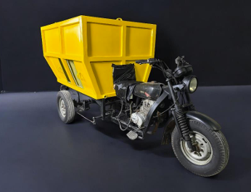
Prototype Evaluation & Validation
EVALUATION RESULTS
The dimensions are sufficient to accommodate the intended types of waste; fiberglass is considered a suitable alternative to iron, offering comparable durability.
ADVANTAGES OF THE PROTOTYPE
• Trapezoidal shape
• Sorting partition
• Drainage
• User access
Development Input
1. Add a rear door to make it easier to remove trash.
2. Add a rear tire fender to prevent dirt from hitting the tub.
CONCLUSION: The trapezoidal fiberglass prototype integrates sorting, drainage, and access to support transport efficiency.

Slide 10
CONCLUSION
Final design of a three-wheeled motorcycle waste bin based on the needs of sanitation workers.
KEY ISSUES
DESIGN REQUIREMENTS
DESIGN OUTCOME
The container is prone to corrosion → suboptimal for holding liquid waste → poses a risk of liquid spilling onto the road.
• Corrosion-resistant
• Segregation of organic, inorganic, and hazardous (B3) waste
• Container lid
• Liquid management
Fiberglass three-wheeler cargo bed featuring sorting partitions and a drainage system.
KEY PRODUCT FEATURES
01
Sorting partition
02
Drainage
03
Fiberglass
04
Product color
Organic • Inorganic • Hazardous and Toxic Waste (B3)
Managing residual water/liquid
More corrosion-resistant
Adapted for Environmental Agency (DLH) vehicles
TEST RESULTS
The product was deemed to meet user needs, with input provided for refining the design in the next iteration.
FURTHER DEVELOPMENT
Rear door • Fender • thicker fiberglass
The waste bins are designed with the needs of sanitation workers in mind, specifically to address corrosion, waste sorting, and the management of leachate.

Slide 11
Thankyou
Presented by:
Alvian Fajar Setiawan
Andrianto
Divani Nazhifah
Affiliation:
Telkom University
Indonesia

