Slide 1
ICADE 2026
9th International Conference on Arts and Design Education
Universitas Pendidikan Indonesia
RESEARCH PAPER PRESENTATION
Metamorphosis of Empathy into the Moving Body
An Analysis of Burnout Choreographic Process Based on Medical Profession Experiences
Sayraz Melda Sangwara
Contact & Affiliation
Master’s Program in Arts Education, Universitas Pendidikan Indonesia (UPI)
Bandung, Indonesia

Slide 2
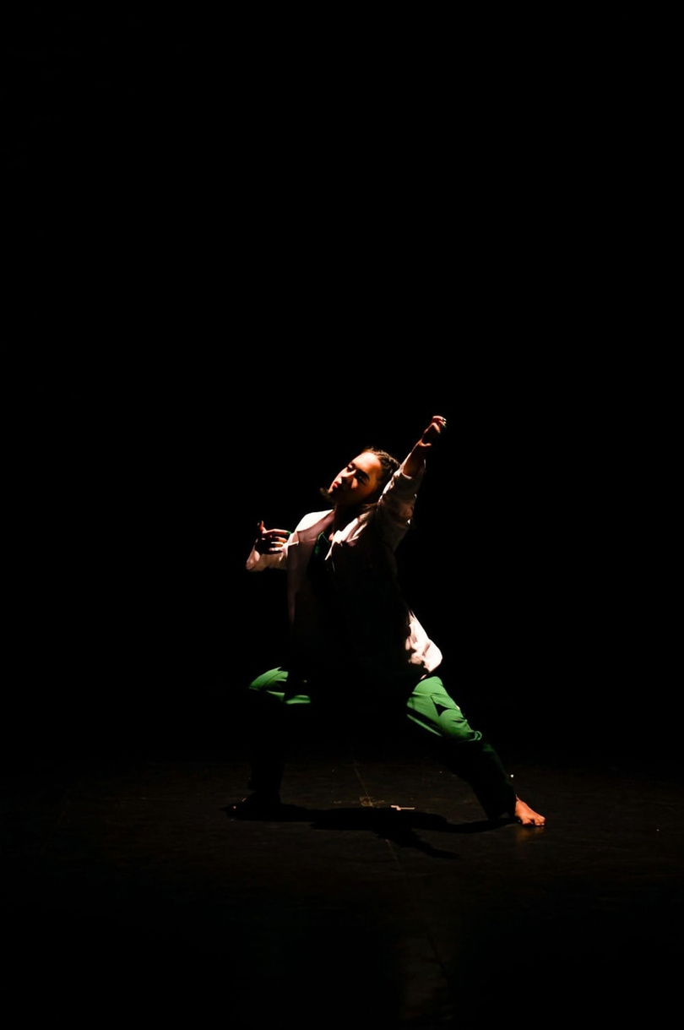

01. Introduction
Background & Research Urgency
Contemporary Choreography & Social Reality
Dance as Critical Medium
Moves beyond formal visual aesthetics to respond and reflect upon pressing social realities.
Healthcare Burnout Phenomenon
Inspired by 'Burnout' (Sangwara, 2025), addressing post-pandemic medical exhaustion in hospitals.
The Choreographic Challenge
Preventing movement from becoming superficial visual imitation through deep empathy metamorphosis.
ICADE 2026 Presentation
Slide 2

Slide 3


02. Method
Research Question & Analytical Framework
Qualitative Document Analysis
Primary Research Question
How is empirical medical research transformed and internalized into bodily language and kinesthetic movement quality within the contemporary work 'Burnout'?
1
2
3
4
Data Reduction
Emotional Transposition
Body Deconstruction
Pathway Synthesis
Distilling empirical field notes and medical interview data.
Mapping psychological burnout states to physical body states.
Analyzing kinesthetic movement qualities and body posture.
Synthesizing the empathy metamorphosis pathway.
ICADE 2026 Presentation
Slide 3

Slide 4
03. Discussion
Research Findings & Emotional Embodiment
Transposing Empirical Experience to Body
Physical Burden
Anxiety & Tension
Emotional Repression
MEDICAL REALITY
MEDICAL REALITY
MEDICAL REALITY
Extreme physical fatigue & double shifts.
Hidden panic during ER interventions.
Required professional calm before patients.
KINESTHETIC EMBODIMENT
KINESTHETIC EMBODIMENT
KINESTHETIC EMBODIMENT
Heavy movement quality, physical collapse, and slow, labored dynamics.
Staccato movements, sudden muscle spasms, and rigid posture.
Restrained movements and exploration of confined personal space.
ICADE 2026 Presentation
Slide 4

Slide 5

04. Articulation
Dramatic Articulation & Transdisciplinary Practice
Core Dance Elements
Kinesthetic Articulation Elements
Time / Rhythm
Constant tempo shifting to erratic, rapid beats representing racing pulse.
METHODOLOGICAL IMPLICATION
Transdisciplinary Practice-as-Research
Contemporary choreography must transcend formal stylistic aesthetics. Integrating social research and empathy mapping creates authentic movement generators that resonate beyond decorative dance.
Space / Kinesphere
Confined personal space symbolizing psychological isolation and entrapment.
Energy / Dynamics
Contrastive force shifting from extreme muscular tension to total physical collapse.
ICADE 2026 Presentation
Slide 5

Slide 6
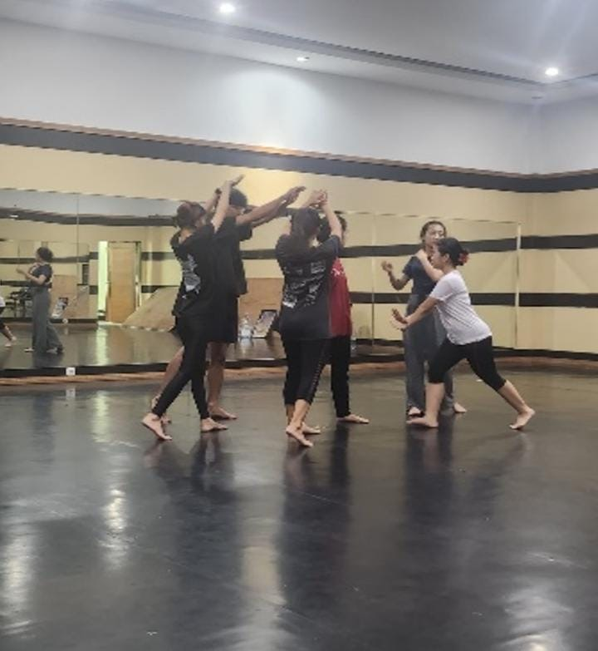
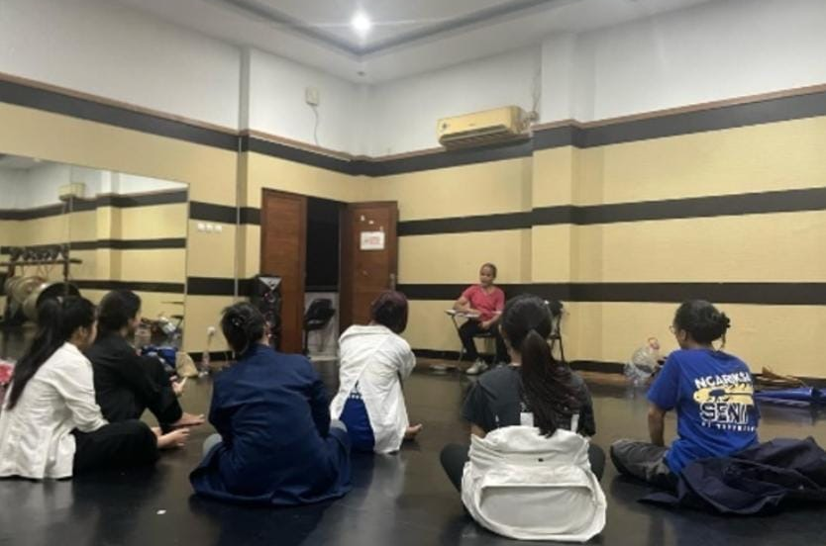
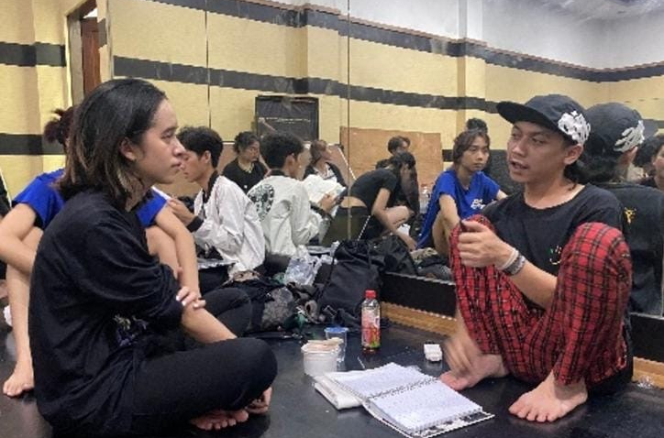
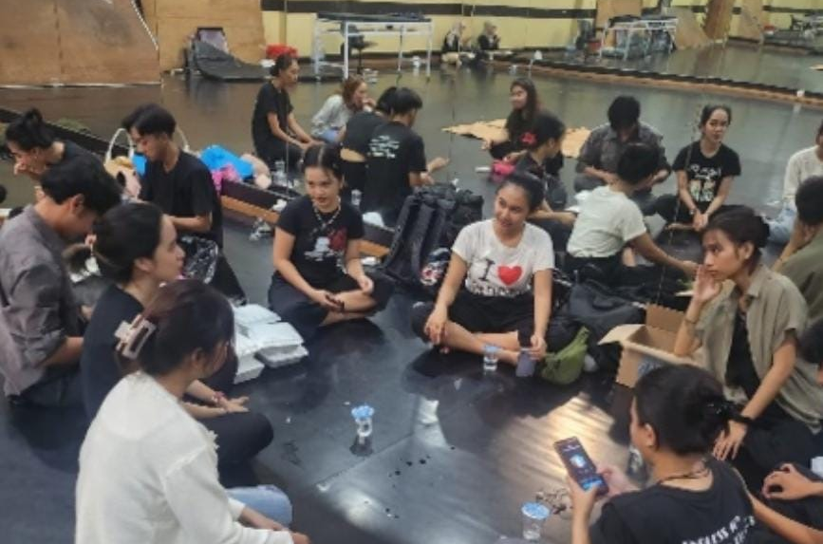
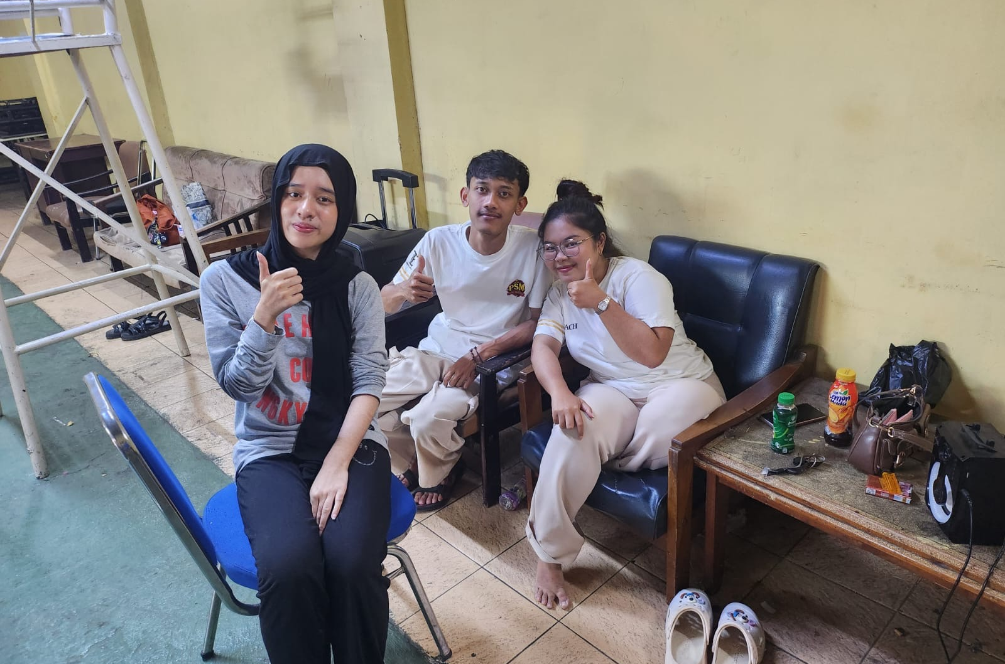
05. Documentation
Documentation of the Interview and the Process
ICADE 2026 Presentation
Slide 6

Slide 7

06. CONCLUSION
ICADE 2026 Presentation
"Research-driven empathy acts as a powerful choreographic generator—transforming empirical human reality into compelling kinesthetic language."
Metamorphosis of empathy offers a structured methodological pathway for research-led contemporary dance creation, bridging social science and somatic performing arts.
Thank You Very Much
Sayraz Melda Sangwara
I welcome any questions, feedback, or discussion.
Universitas Pendidikan Indonesia (UPI)

